Slide 1
Shared Innovation Space for Sustainable Productivity of Grasslands in Europe
Project Acronym: Inno4Grass
Project Number: 727368
Deliverable 5.3. Power point presentations available for young farmers and advisors
Responsible partner: TEAGASC (WP leader)
Task leader and lead editor: AERES (Eds)
Contributors: AERES, GLZ, TEAGASC, WR, RHEA, IDELE, APCA, LWK, UGOE, TRAME, AWE, SLU, NLTO, CNR, PULS, WIR, AIA, LRC
Submission date: 28 February 2019

Slide 2
Inno4Grass – Education material on practical grassland management in 8 European countries

Slide 3
Table of contents
This powerpoint consists of contributions of several countries
The material has been provided by the partners of the different countries
Sweden
Ireland
The Netherlands
Belgium
Germany
Poland
France
Italy
(You can use the hyperlink to go to a specific country)

Slide 4
Sweden

Slide 5


Characteristics of grassland production and utilisation in Sweden
Nilla Nilsdotter-Linde
Eva Spörndly
Rolf Spörndly

Slide 6
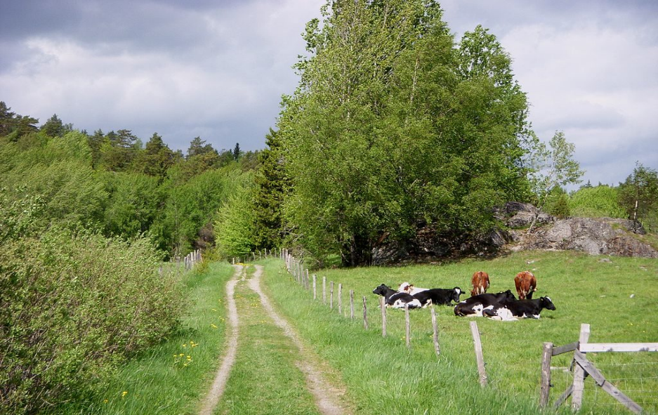
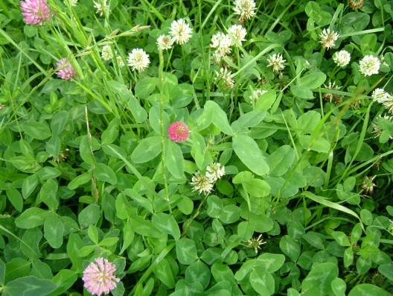
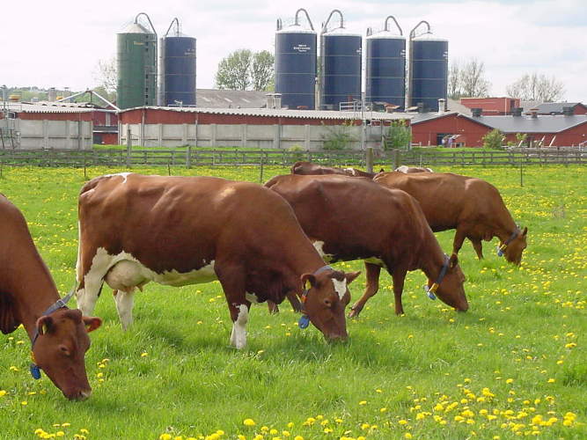
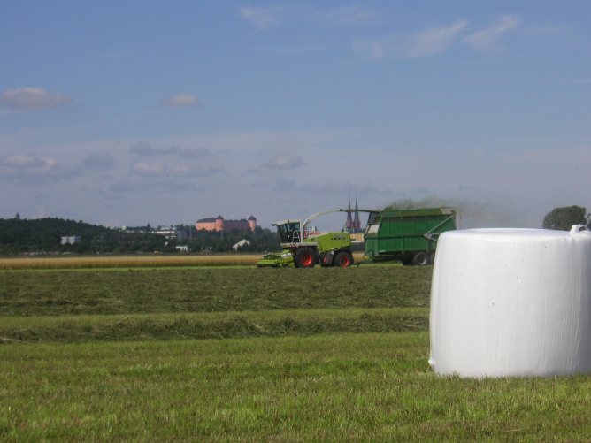
Photo: Timbro.se
Photo: Nilla Nilsdotter-Linde
Photo: Rolf Spörndly
Photo: Rolf Spörndly

Slide 7
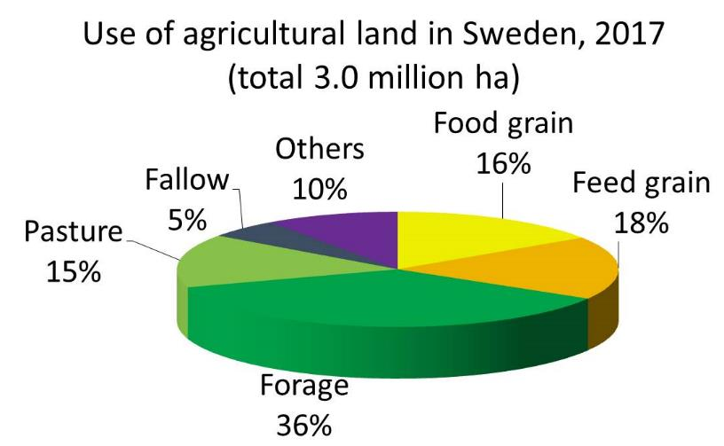
Land use in Sweden
Sweden is a vast country of forests and mountains…..
Total Sweden 45 mil. ha
with:
- Forest - 24 mil. ha
- Heathland/peat - 7 mil. ha
- Mountains/hills - 5 mil. ha
- Water - 4 mil. ha
- Agriculture - 3 mil. ha
- Built/cities/roads - 2 mil. ha
(Swedish Board of Agriculture, 2018)
19% of agricultural land is in organic production
~75% of agricultural land is used for feed production

Slide 8
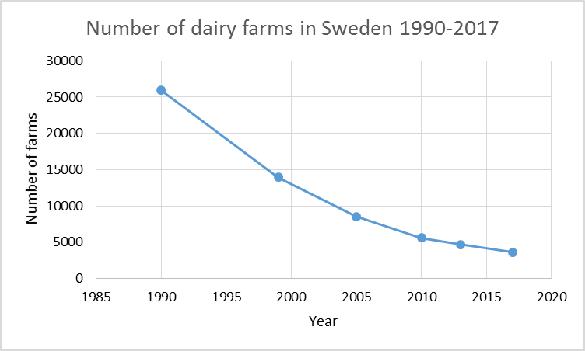
Number of dairy farms in Sweden, 1990-2017
Table of contents
91 cows per herd in 2018 (85 in 2016)
(Swedish Board of Agriculture, 2018)

Slide 9
The typical ration for the high-yielding dairy cow
11-13 kg DM silage. Grass/clover, pre-wilted
7-9 kg rolled cereals. Barley, oats, wheat
5-7 kg protein concentrates
Rape seed meal is the most common protein feed, followed by soy bean meal. Palm cake and sugar beet pulp are important ingredients in the concentrate
Year | Feed ration
1975 | 7 kg hay + 10 kg concentrate* (shift from hay to silage)
1982 | 11 kg DM silage + 10 kg concentrate (75/10/15)*
1986 | 9 kg DM silage + 13 kg concentrate (60/20/20)*
1994 | 7 kg DM silage + 16 kg concentrate (50/30/20)*
2005 | 9 kg DM silage + 16 kg concentrate (50/30/20)*
2015 | 12 kg DM silage + 15 kg concentrate (50/30/20)*
* = grain/sugar beet pulp/oil seed cake (%).

Slide 10
Typical milk yield for the high-yielding dairy cow
11-13 kg DM silage. Grass/clover, pre-wilted
7-9 kg rolled cereals. Barley, oats, wheat
5-7 kg protein concentrates
Rape seed meal is the most common protein feed, followed by soy bean meal. Palm cake and sugar beet pulp are important ingredients in the concentrate
Year | Feed ration | Milk yield per cow/year (kg)
1975 | 7 kg hay + 10 kg concentrate* (shift from hay to silage) | 5500
1982 | 11 kg DM silage + 10 kg concentrate (75/10/15)* | 6200
1986 | 9 kg DM silage + 13 kg concentrate (60/20/20)* | 6700
1994 | 7 kg DM silage + 16 kg concentrate (50/30/20)* | 7600
2005 | 9 kg DM silage + 16 kg concentrate (50/30/20)* | 8500
2015 | 12 kg DM silage + 15 kg concentrate (50/30/20)* | 10 000
* = grain/sugar beet pulp/oil seed cake (%).

Slide 11
High intake is totally dependent on high-quality forage
– grass/clover dominates
  Date of harvest is more important in pure grass leys than in mixed leys.

Slide 12
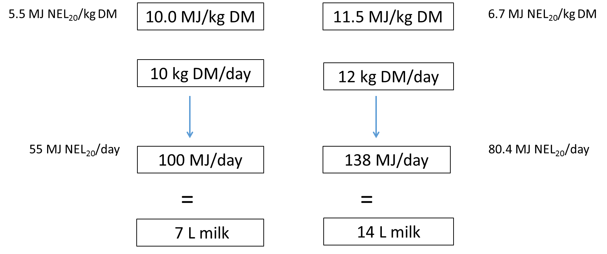
Date of harvest has a ‘turbo’ effect on forage quality due to higher intake of early harvested forage
Late harvest
Early harvest
Silage intake
Silage intake

Slide 13
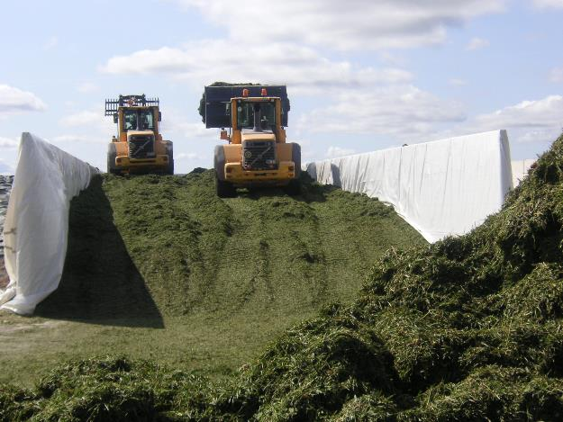
Excellent silage for dairy cows
Good nutritional value
  Energy 11-11.5 MJ/kg DM
  Crude protein 130-160 g/kg DM
  DM 30-35%
  Fibre 450-550 g NDF/kg DM
Palatable – high sugar content
Good hygiene quality
Photo: Rolf Spörndly

Slide 14
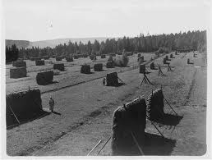
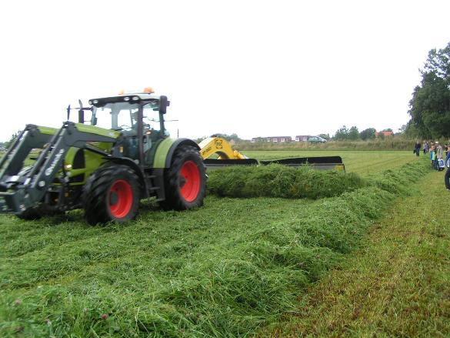
Forage has to be preserved for an 8-month winter period. In the past, hay-making was the only available method
1970s and 1980s – transition from hay to silage
  Larger farms
  Less weather-dependent
  Lower nutrient losses
  Higher milk production
After 1980, silage making took over and is now the dominant harvesting method
Photo: Rolf Spörndly

Slide 15
Daily feed data intake and animal performance data. Early cut at booting stage and late cut 10 days later
 | Early cut hay | Early cut silage | Late cut silage
Forage intake, kg DM day⁻¹ | 8.7ª | 8.4^{b} | 8.5^{b}
Concentrate intake, kg DM day⁻¹ | 8.1 | 8.4 | 8.6
Energy intake, MJ day⁻¹ | 197 | 199 | 194
Milk production, kg day⁻¹ | 26.1ª | 27.4^{b} | 26.2ª
Milk fat content, % | 4.56 | 4.65 | 4.57
Fat-corrected milk, kg ECM day⁻¹ | 28.6ª | 30.5^{b} | 28.3ª
Three-year ley fertilised with 89 kg N, species timothy, meadow fescue and red clover.
Hay wilted to 60% in the field and to 87% DM in indoor drying.
Silage direct-cut, 26% DM.
Forage fed restricted, concentrate according to milk yield.
Lactation week 2-10, year 1.
The key to higher milk production with silage is the possibility to cut it early!
(From Bertilsson, 1983)

Slide 16
Silo systems in Sweden
Expressed as % of total quantity of silage
Bunker silo
Tower silo
Wrapped forage
(Pettersson et al., 2009)

Slide 17
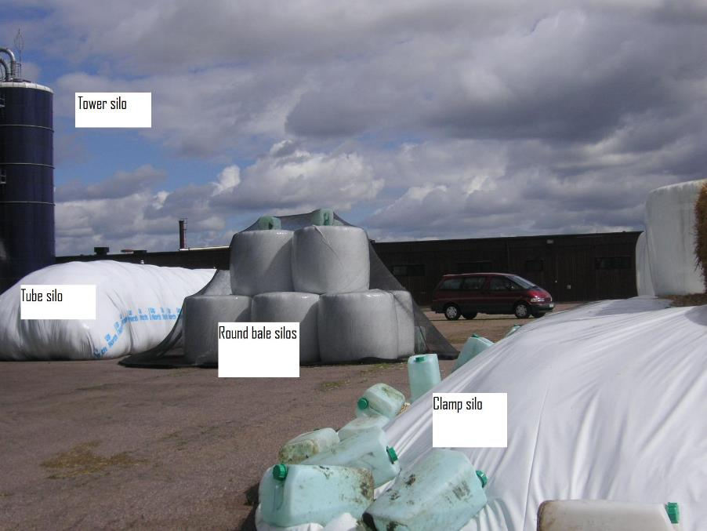
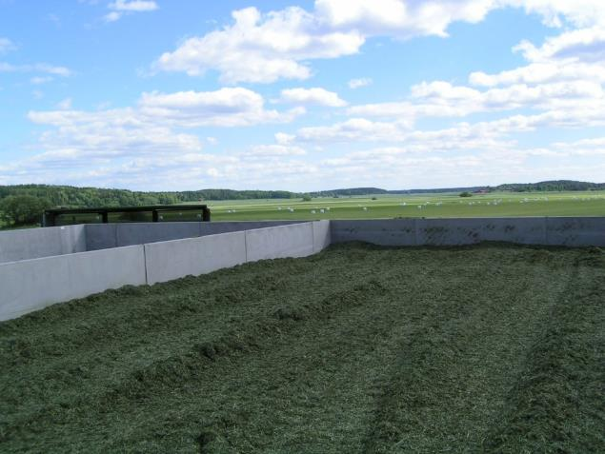
Silo systems
Photo: Rolf Spörndly
  1980s – wooden tower silos
  1990s – steel tower silos
  2000s – bunker silos and round bales
Photo: Rolf Spörndly

Slide 18
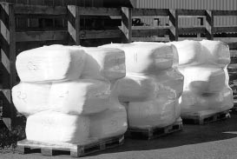
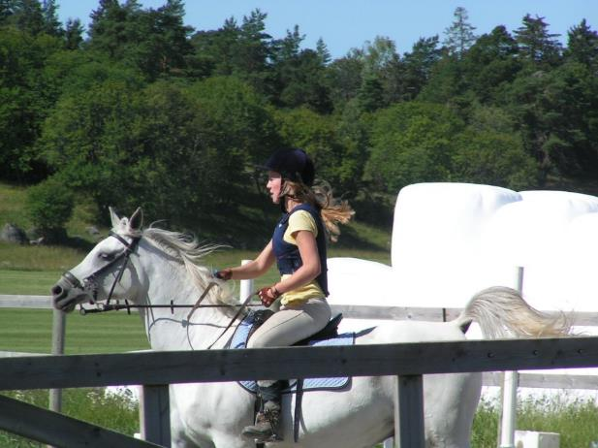
In Sweden, wrapping is the most common silo system for silage from grassland
Wrapped silage is used on small and medium-sized dairy farms, as a complement on large dairy farms, for beef cattle and also for horses in Sweden
Livestock in Sweden | Number
Dairy cows | 322 000
Beef cows | 207 000
Young stock | 499 000
Calves | 472 000
Total cattle | 1 500 000
Ewes, ram | 301 000
Lamb | 305 000
Total sheep | 606 000
Total horses | 355 000
Photo: Rolf Spörndly
Photo: Eva Spörndly
(Swedish Board of Agriculture, 2018)
Note: There are more horses than dairy cows in Sweden!

Slide 19
Recent research on dry matter losses from different silo systems
  Materials and Methods
  12 bunker silos, 6 tube silos, 3 tower silos and 60 round bales
  Located on 12 different farms
  Silo balances (all in – all out) recorded
  Large silos: All loads going in were weighed and sampled, all loads going out were weighed but sampled three times per week
  Round bales: All bales were weighed before and after storage and every second bale was sampled
(Spörndly, 2018)

Slide 20
Recent research indicates lower losses from wrapped forage than from large silos and surprising results about filling speed of bunker silos
 | DM loss, %
 | Total | Discarded
Bunker | 14.1ª (8.7) | 3.4 (4.4)
Tube | 11.5^{b} (9.4) | 1.9 (3.8)
Tower | 23.4^{ab} (2.2) | 0.1 (0.1)
Round bales | 1.1^{c} (0.4) | 0.0 (0.0)
(Spörndly, 2018)

Slide 21
Dry matter losses from different silo systems
  Conclusions
  Considerably lower silage DM losses in round bale silage than in large silos (bunker, tube, tower)
  Discarded silage losses low (1-4%), but invisible DM losses high (10-20%) in large silos
  Great variation in DM losses between farms for each large silo system
  Slow filling and careful compaction are key to low losses in bunker silos
(Spörndly, 2018)

Slide 22
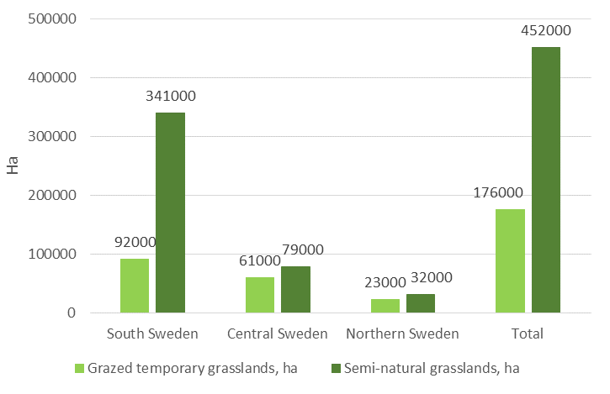
Area of semi-natural grassland and grazed temporary grassland in Sweden, 2017 (ha)
(Swedish Board of Agriculture, 2017)

Slide 23
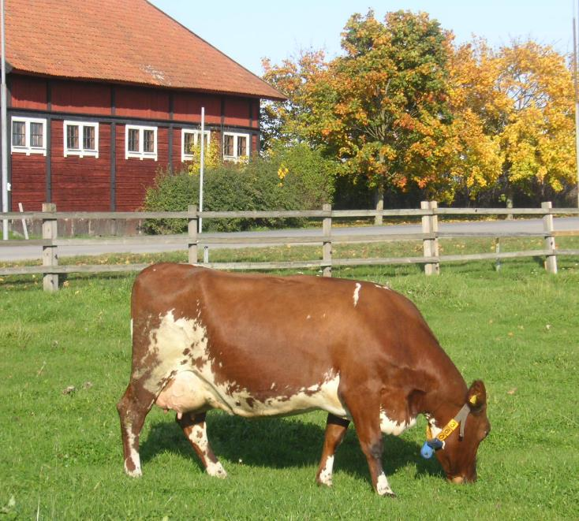
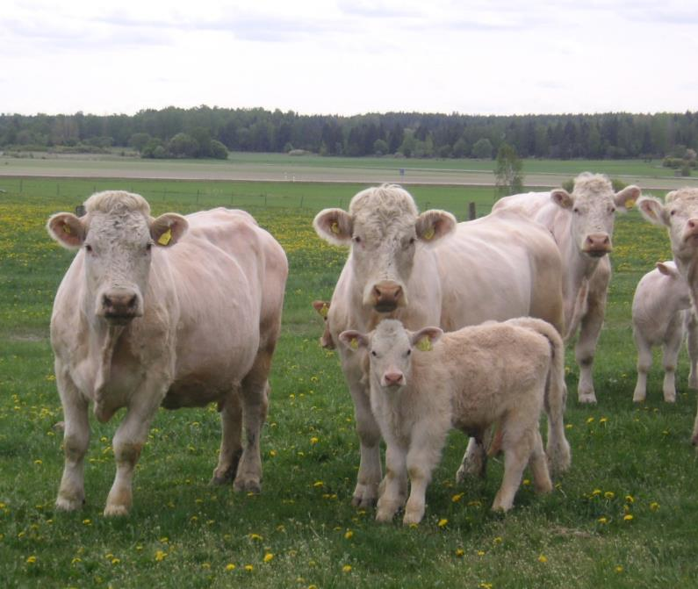
Temporary grassland is best suited for dairy cows (e.g. Swedish Red breed and Swedish Holstein) and heavy beef breeds (e.g. Charolais)
Photo: Eva Spörndly
Photo: Eva Spörndly

Slide 24
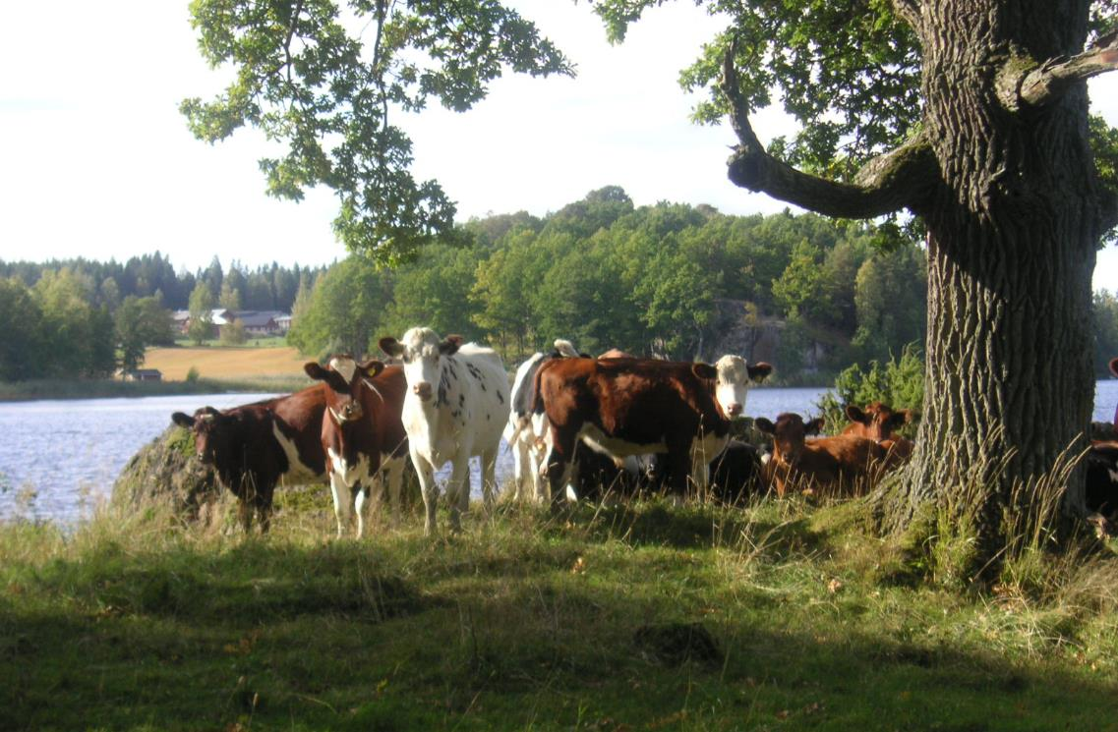
Semi-natural permanent pastures in Sweden are best suited for lighter beef breeds, recruitment heifers, horses and sheep
Photo: Eva Spörndly

Slide 25

Swedish legislation requires pasturing during summer
  Dairy cows must have access to pasture for at least 6 h/day
  Other cattle¹ and sheep must be kept on pasture for 24 h/day Exceptions are bulls and young calves (below 6 months)
  The required length of grazing period is 60 days in northern Sweden, 120 days in southern Sweden
  ¹Suckler cows and their calves, recruitment heifers, dry cows etc.
(Swedish Board of Agriculture, 2016)

Slide 26
Grazing systems and pasture use
1. Dairy cows
  Dairy cows in conventional production
  The law requires at least 6 h pasture access/day
  In 2018, Sweden’s largest dairy company introduced an extra payment for +25% more grazing on pasture than required by law. Many farmers have signed up for the system
  Large amounts of supplementary concentrates (50% of DM intake)
  Supplementary silage is often provided
  Mainly grazing temporary grass swards with high digestibility

Slide 27
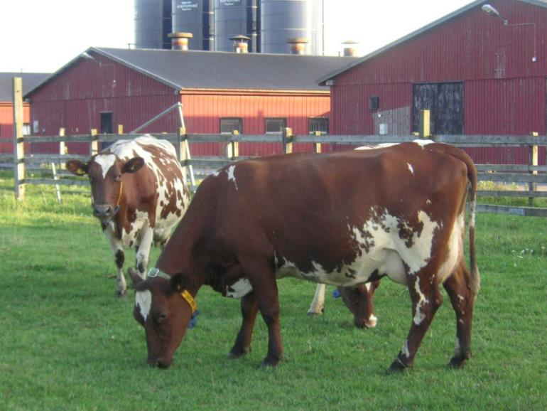
Dairy cows in organic production
  Must be on pasture for longer than 12 h/day
  Daily pasture intake must be at least 6 kg DM daily
  Mainly grazing temporary grass swards with high digestibility
Photo: Eva Spörndly
(KRAV, 2018)

Slide 28
Organic production in Sweden
Organic production | Proportion of total agricultural area or animal stock (%)
Total acreage | 19.1
Cereal grain (wheat, barley, oats, rye, triticale) | 9.5
Forage (legumes/grass, green fodder, ploughed) | 22.1
Semi-natural pasture | 24.6
Dairy cows | 16.4
Beef cows | 33.7
Sheep | 20.9
Pigs | 2.3
Laying hens | 17.0
Broilers | 1.9
  Increasing in all sectors
  Particularly pronounced in forage and cattle production
(Swedish Board of Agriculture, 2018)

Slide 29
Automatic milking (AM) and grazing
  Approximately one-third of milk in Sweden is produced in AM systems
  Conventional (non-organic) farms with AM often graze mainly to fulfil the legal requirement, and provide exercise pasture combined with substantial amounts of concentrates and silage indoors
  AM systems are also common in organic production, but with at least 6 kg DM from pasture/day in the diet
  The EU research project AUTOGRASSMILK provides more information about AM and grazing in Sweden and other European countries (https://autograssmilk.dk/)

Slide 30
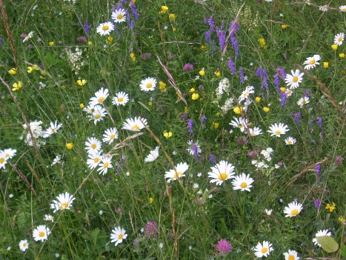
Grazing systems and pasture use
2. Sheep and cattle for growth and meat production
  Animals that are required to graze 24 h daily (cattle and sheep):
  Graze to a large extent on permanent semi-natural pastures
  Swedish farmers receive subsidies for grazing permanent semi-natural pastures, as these pasture areas have high biodiversity
  Many semi-natural pastures are important for threatened species in Sweden: flowers, insects, birds etc.
Photo: Eva Spörndly

Slide 31
Semi-natural pastures are more species-diverse than temporary grassland
Vegetation type in semi-natural Swedish pastures | Herbage mass, kg DM/ha and season | Metabolisable energy, average over season, MJ/kg DM
Dry | 1800 | 9.5
Mesic | 3000 | 9.7
Wet | 4400 | 8.6
Shaded | 1400 | 9.0
(Spörndly and Glimskär, 2018)

Slide 32
Cattle, horses and sheep grazing on semi-natural permanent pastures
% of acreage, sites and number of grazing animals. N = 219 sites, with an average size of 14 ha
 | % of acreage | % of grazing sites | % of grazing animals
Cattle | 68 | 64 | 66
Horses | 8 | 18 | 5.5
Sheep | 9 | 11 | 28.5
Mixed¹ (mainly cattle & sheep) | 15 | 7
¹In this category there were two large sites (242 and 112 ha) that were grazed by cattle and sheep.
(Spörndly and Glimskär, 2018)

Slide 33
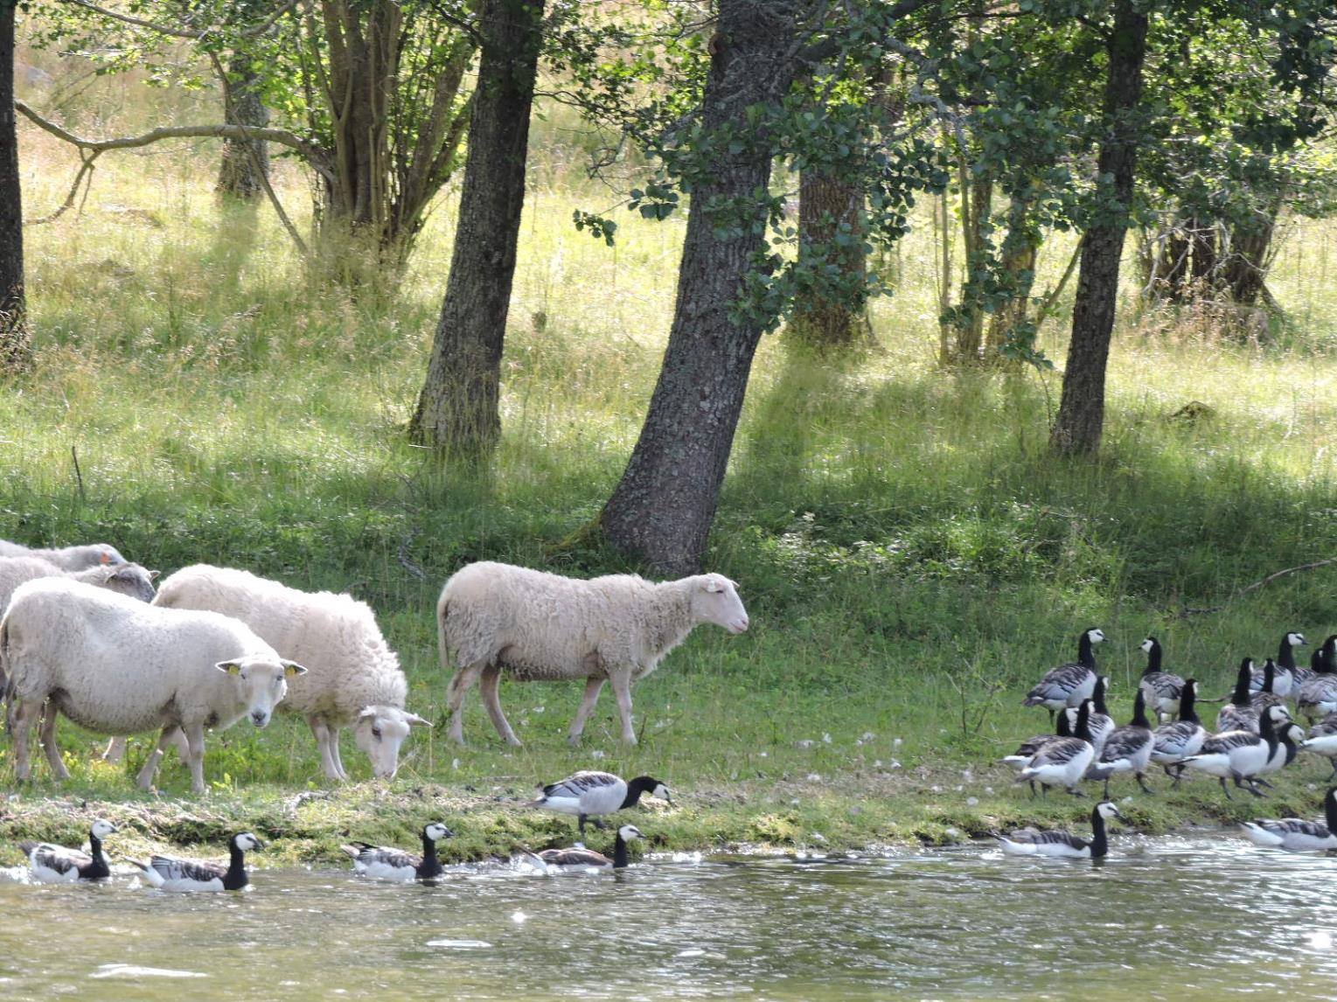
Photo: Eva Spörndly

Slide 34
Length of the growing season in Europe
Length of the growing season, days >5°C
These conditions result in some species being better adapted….

Slide 35
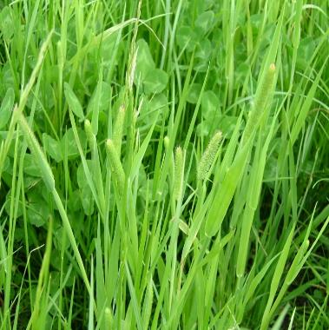
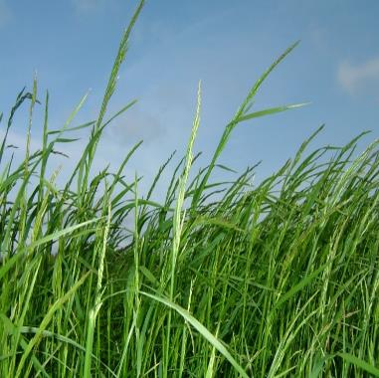
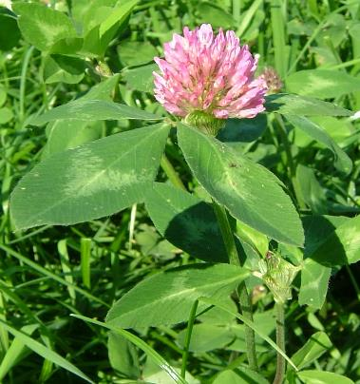
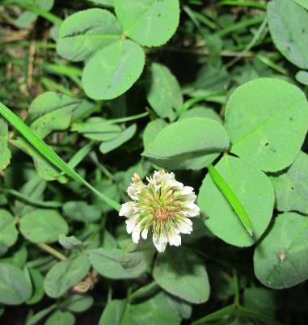
The following species are among the best adapted in grasslands in Sweden
Timothy
(Phleum pratense)
Meadow fescue
(Festuca pratensis)
Red clover
(Trifolium pratense)
White clover
(Trifolium repens)
Photos: Nilla Nilsdotter-Linde

Slide 36
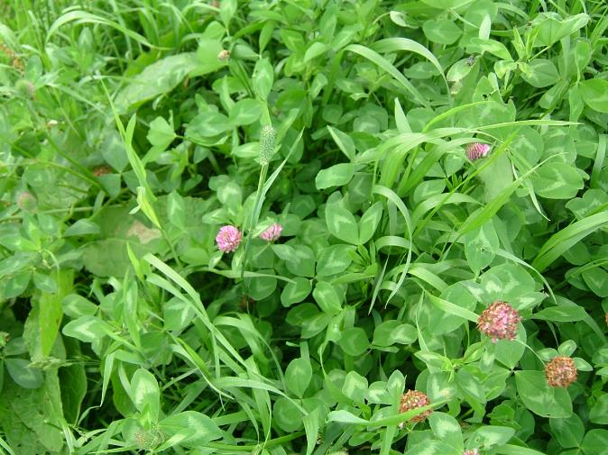
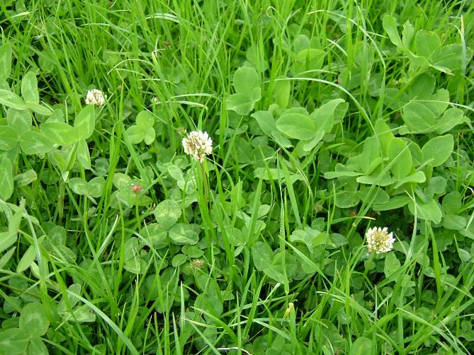
In Sweden, short-term leys as part of arable crop rotations are the main forage crop, unlike the perennial forage swards farther south in Europe
  The traditional mixture for hay and silage is red clover, timothy and meadow fescue
  The traditional mixture for grazing is white clover, meadow fescue, perennial ryegrass and smooth-stalked meadow grass
Photo: Nilla Nilsdotter-Linde
Photo: Nilla Nilsdotter-Linde

Slide 37
DM yield is lower but organic matter digestibility (OMD) is higher with three cuts compared with two cuts a year in swards with grass (timothy and meadow fescue) and in swards with grass and clover (100 kg N per ha)
(Kornher, 1982)

Slide 38
In the 1980s, more erect varieties of white clover were introduced and tested for potential inclusion in mixed, short-term leys
1. | Seed mixture
A. | Red clover (5) + Timothy (10) + Meadow fescue (7)
B. | White clover (5) + Timothy (10) + Meadow fescue (7)
C. | White clover (5) + Timothy (10) + Meadow fescue (7) + Smooth-stalked meadow grass (3)
2. | Fertilisation strategy (N)
N0. | 0 kg/ha
N1. | 100 kg/ha
N2. | 200 kg/ha
3. | Cutting strategy
S1. | 3 cuts/year (~13/6, 25/7, 5/9)
S2. | 3 cuts/year (~6/6, 18/7, 5/9)
S3. | 4 cuts/year (~6/6, 4/7, 1/8, 5/9)
(Svanäng and Frankow-Lindberg, 1994)

Slide 39
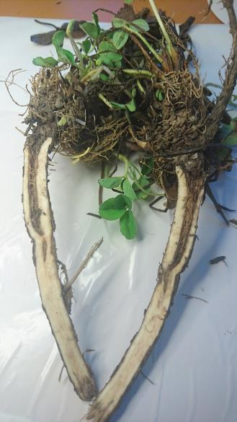
White clover compared with red clover in mixed, short-term leys
N level | Trifolium ssp. | 1st year | 2nd year | 3rd year | 4th year
0 kg N | Red clover | 8 430 | 7 647 | 6 363 | 5 491
 | White clover | 7 724 | 8 085 | 7 441 | 7 765
100 kg N | Red clover | 9 597 | 9 359 | 7 795 | 7 141
 | White clover | 9 123 | 9 534 | 8 169 | 8 152
200 kg N | Red clover | 10 409 | 10 202 | 8 569 | 8 213
 | White clover | 9 920 | 10 246 | 8 619 | 8 565
Photo: Ann-Charlotte Wallenhammar
  On average for different fertilising and cutting regimes (3 or 4 cuts/year), white clover/grass mixtures were found to be better than red clover/grass mixtures
  Red clover yielded more in young leys, but white clover persisted for longer
  Root rot is the major obstacle to more long-lived red clover swards
(Svanäng and Frankow-Lindberg, 1994)

Slide 40
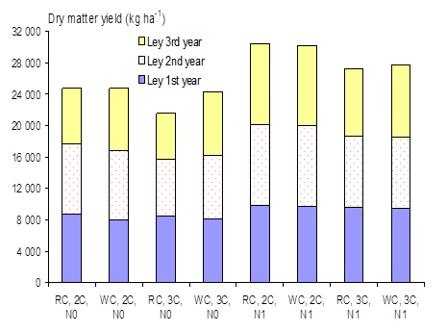
Can white clover be recommended in areas with less intense production due to farming tradition and climate conditions?
  Two cuts gave higher total yields than three
  Digestible energy was lower with two cuts than with three
  On average, the difference between red and white clover yield was small, but in the third year unfertilised white clover yielded more than unfertilised red clover
  RC = red clover, WC = white clover
  2C = 2 cuts/year, 3C = 3 cuts/year
  N0 = 0 kg N/ha, N1 = 100 kg N/ha
  Grasses = timothy and meadow fescue
  N = 11
  (Nilsdotter-Linde et al., 2002)

Slide 41
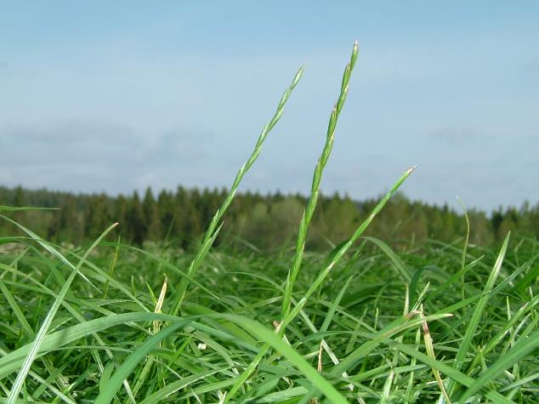
With the arrival of intensive harvesting systems and more white clover in silage leys, ryegrasses have become more interesting
  These species are not as prevalent in Scandinavia as farther south because their longevity is more or less restricted depending on climate conditions, with winter kill always a threat
  Perennial ryegrass is only recommended in the southern third of Sweden
Photo: Nilla Nilsdotter-Linde

Slide 42
Late autumn cutting was tested as a way to reduce damage caused by e.g. snow mould (Fusarium nivale) and thus improve winter survival in perennial ryegrass
  Effect of autumn cutting management on subsequent dry matter (DM) yield in perennial ryegrass (mean different varieties)
 | Yield, 10³ kg DM/ha
 | 2nd year |  |  |  |  | 3rd year
Treatment | 1st cut | 2nd cut | 3rd cut | Total yield |  | 1st cut
With late autumn cut | 3.31 | 1.94 | 2.56 | 7.81 |  | 2.40
Without late autumn cut | 4.46 | 1.92 | 2.71 | 9.11 |  | 3.25
Significance | ** | NS | NS | * |  | **
  Cutting as late as possible before cessation of growth significantly reduced the following spring yield by about 25% in both the second and third year
  No residual effect of late autumn cutting on subsequent cuts
  Ryegrass still has problems with winter kill and remains a minority grass in Swedish leys
  (Halling, 1994)

Slide 43
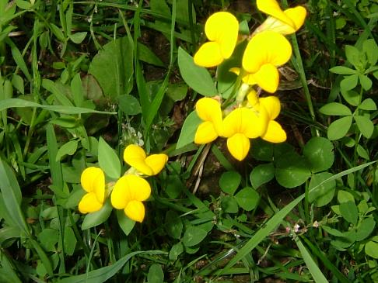
Trends for the future
  There is now renewed interest in producing home-grown protein to replace imported protein
  Deeper knowledge about cultivation of grasses and legumes that are more tolerant to dry and/or wet conditions is important, to better cope with future climate change
  There is increasing interest in species with special qualities, e.g. water-soluble carbohydrates and condensed tannins
  Studies on birdsfoot trefoil, a minor forage legume containing condensed tannins, confirm that it can withstand Swedish climate conditions
Photo: Nilla Nilsdotter-Linde

Slide 44
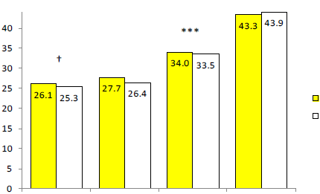

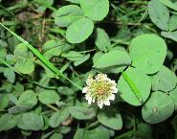
Milk yield and milk composition for dairy cows fed birdsfoot trefoil-ryegrass silage or white clover-ryegrass silage in changeover experiments in two consecutive years (N = 76)
Birdsfoot trefoil
White clover
***P < 0.001; †P < 0.10
Milk ECM Protein Fat
kg/d kg/d g/kg DM g/kg DM
(Eriksson et al., 2012)
A tendency for higher milk yield and somewhat higher milk protein content resulted in higher protein yield with the birdsfoot trefoil-ryegrass silage, but ECM yield did not differ significantly between the diets.

Slide 45
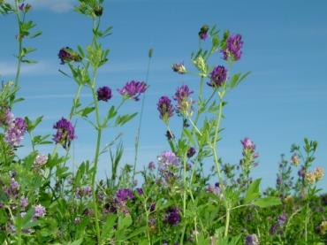
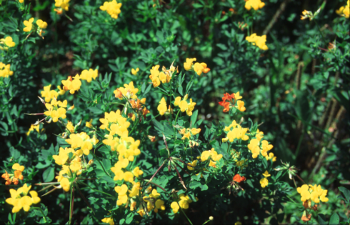
How do the new conditions influence seed selection?
  More frequent cutting - white clover and perennial ryegrass
  Better winter hardiness - white clover, timothy and tall fescue
  Better fibre quality - timothy and lucerne
  New protein sources - legumes incl. birdsfoot trefoil
  Resulting in the following trends in seed mixtures:
  - Timothy
  - Meadow fescue
  - Perennial ryegrass
  - Tall fescue
  - Red clover
  - White clover
  - Lucerne
Photo: Nilla Nilsdotter-Linde
Photo: Nilla Nilsdotter-Linde

Slide 46
References
Bertilsson, J. 1983. Effects of conservation method and stage of maturity upon the feeding value of forages to dairy cows. Dissertation. Swedish University of Agricultural Sciences. Department of Animal Husbandry. Report 104. Uppsala, Sweden.
Eriksson, T., Norell, L. & Nilsdotter-Linde, N. 2012. Nitrogen metabolism and milk production in dairy cows fed semi-restricted amounts of ryegrass-legume silage with birdsfoot trefoil (Lotus corniculatus L.) or white clover (Trifolium repens L.). Grass and Forage Science 67:4, 546-558.
Halling, M.A. 1994. Effect of autumn treatment on winter survival of cultivars of perennial ryegrass (Lolium perenne) under Swedish conditions. 8th General Proceedings of the 15th General Meeting of the European Grassland Federation. Wageningen, The Netherlands, pp 177-180.
Kornher, A. 1982. Vallskördens storlek och kvalitet. Inverkan av valltyp, skördetid och kvävegödsling. Sveriges lantbruksuniversitet. Grass and Forage Reports 1, 5-32. In Swedish.
KRAV. 2018. Regler för KRAV-certifierad produktion utgåva 2018. KRAV ekonomisk förening. Uppsala, Sweden. 308 pp. In Swedish.
Nilsdotter-Linde, N., Stenberg, M. & Tuvesson, M. 2002. Nutritional quality and yield of white or red clover mixed swards with two or three cuttings with and without nitrogen. Grassland Science in Europe 7, 146-147.
Pettersson, O., Sundberg, M & Westlin, H. 2009. Machinery and methods in forage production. Institutet för jordbruks- och miljöteknik. Uppsala, Sweden. Report 377. In Swedish.
Spörndly, E. & Glimskär, A. 2018. Grazing animals and grazing pressure in Swedish semi-natural pastures. Swedish University of Agricultural Sciences. Department of Animal Nutrition and Management. Report 297, 71 pp. In Swedish.
Spörndly, R. 2018. Dry matter losses from different silo structures. Proceedings of the 9th Nordic Feed Science Conference. Uppsala, Sweden, pp. 171-176.
Swedish Board of Agriculture. 2016. SJVFS, 2016:13 L100:6. Regulations of changes in the animal welfare ordinance SJVFS 2010:15, 1-6.
Swedish Board of Agriculture. 2017. Yearbook of agricultural statistics 2017. Swedish Board of Agriculture and Statistics Sweden (SCB).
Swedish Board of Agriculture. 2018. Yearbook of agricultural statistics 2018. Swedish Board of Agricul­ture and Statistics Sweden (SCB).
Svanäng, K. & Frankow-Lindberg, B. 1994. White clover leys. Effect of nitrogen fertilisation and harvest systems. Sveriges lantbruksuniversitet. Institutionen för växtodlingslära. Växtodling 51. 23 pp. With English summary.

Slide 47
Ireland

Slide 48

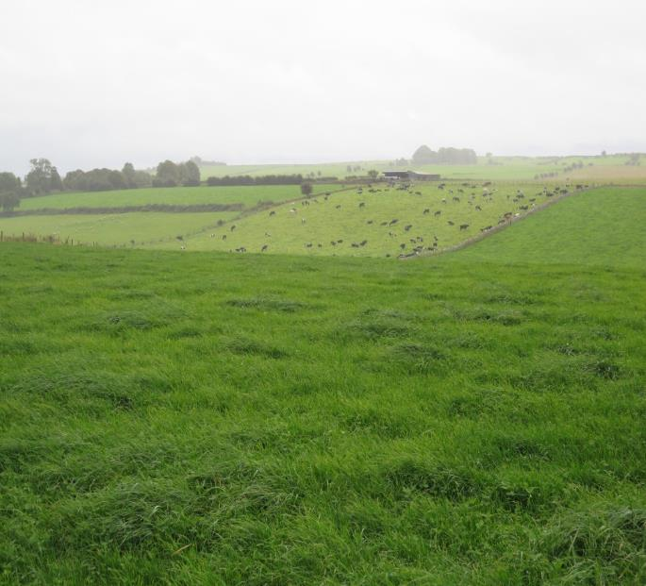
Grassland in Ireland
-
Michael O‘Donovan
& Fergus Bogue

Slide 49
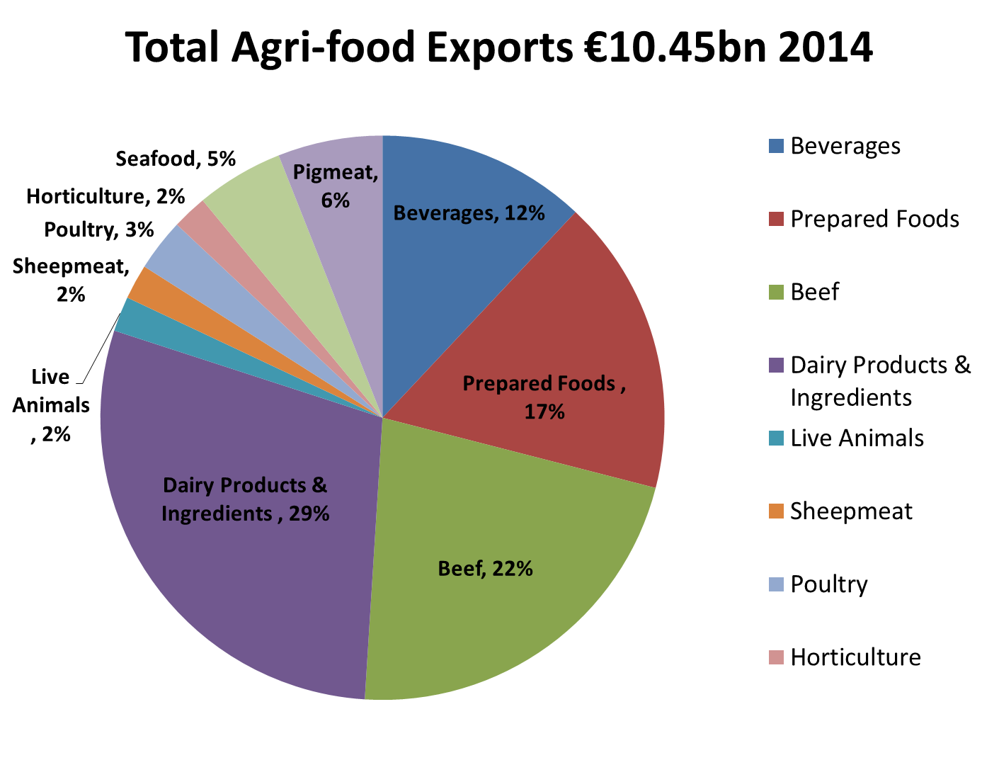
Source : Bord Bia

Slide 50
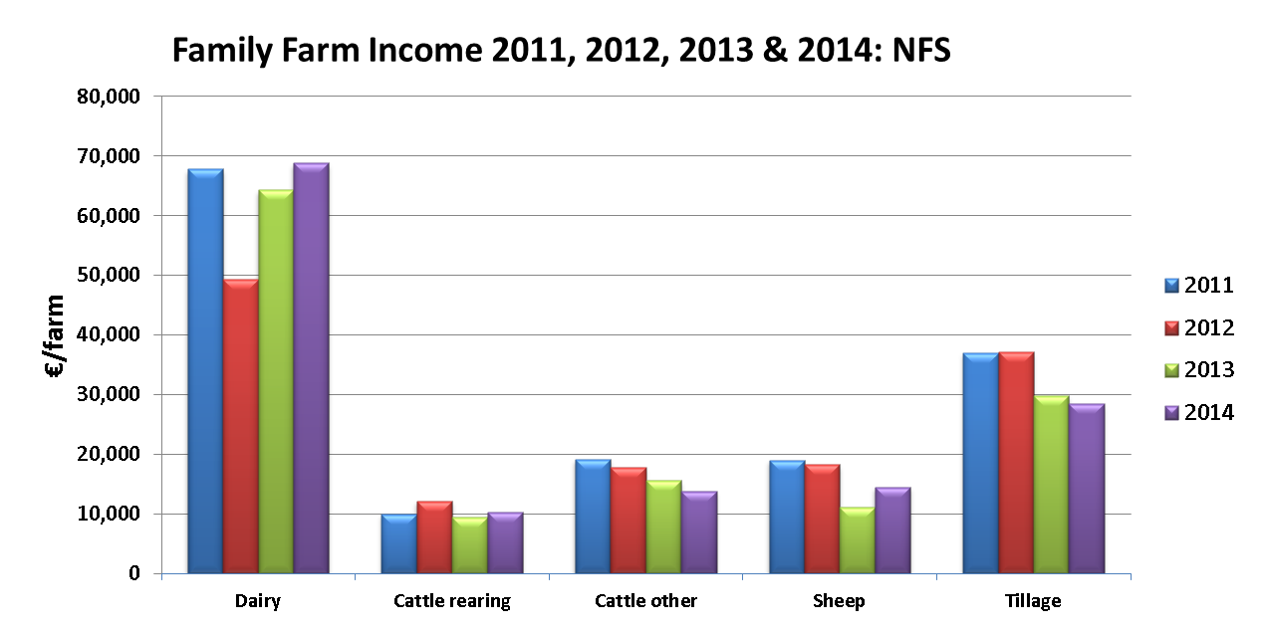
The Efficiency of Agricultural Production In Ireland
Key Technologies
Animal breeding – generating highly profitable animals for grazing system
Grass production & utilisation: soil fertility, grazing management; grass breeding
Farming system: Resilient low cost grass-based

Slide 51
Structure of Irish Dairy Industry
Number of dairy farmers - 18,000
2015: Average herd size-82 cows, farm size-63 ha, producing 350,000 litres
System : Predominately season spring calving pasture pasture-based system
Total of 19 milk processors-82% of milk processed by 6-major processors
2020: 85 cows /herd producing 425,000 liters; 1.4 million dairy cows; 5500 liters/cow 3.55% P & 4.20% F

Slide 52
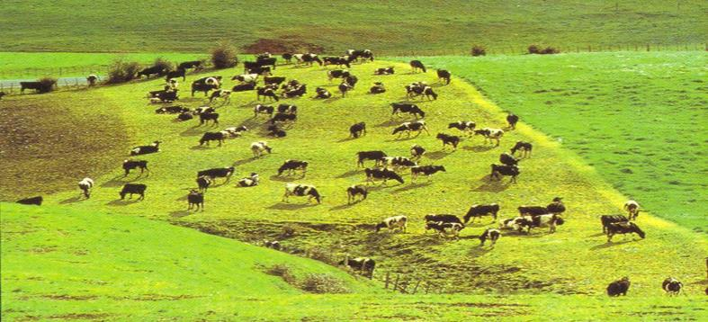
Stocking rate and Grass Utilisation
Profitability of Irish dairying is closely linked to grass utilisation (tons DM/ha)
Increasing SR only profitable when grass utilisation (tonnes DM/ha) increases
Each additional tonne of DM/ha is worth €161/ha
Optimum Stocking rate for Dairy Farms in 2015
 | Pasture grown, t
t supplement DM/cow | 10 | 12 | 14 | 16
0.00 | 1.5 | 2.0 | 2.3 | 2.6
0.25 | 1.7 | 2.1 | 2.4 | 2.8
0.50 | 1.8 | 2.2 | 2.5 | 3.0
0.75 | 1.9 | 2.3 | 2.7 | 3.1

Slide 53
Emissions per kg milk produced in different EU countries
LCA method
Source: Evaluation of the livestock sector’s contribution to the EU GHG emissions (GGELS) EC, Joint Research centre, 2010.

Slide 54
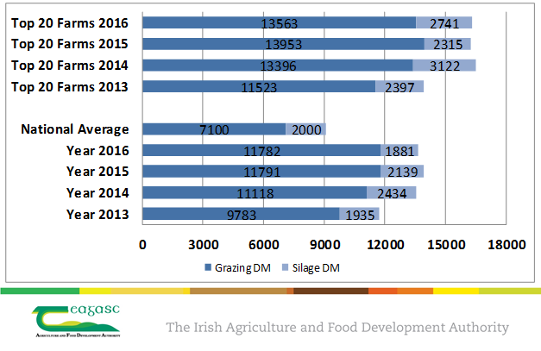
Pasturebase Ireland Dairy Farms DM Production/Ha

Slide 55
Grass DM Production - Beef

Slide 56
Grass DM Production - Sheep

Slide 57
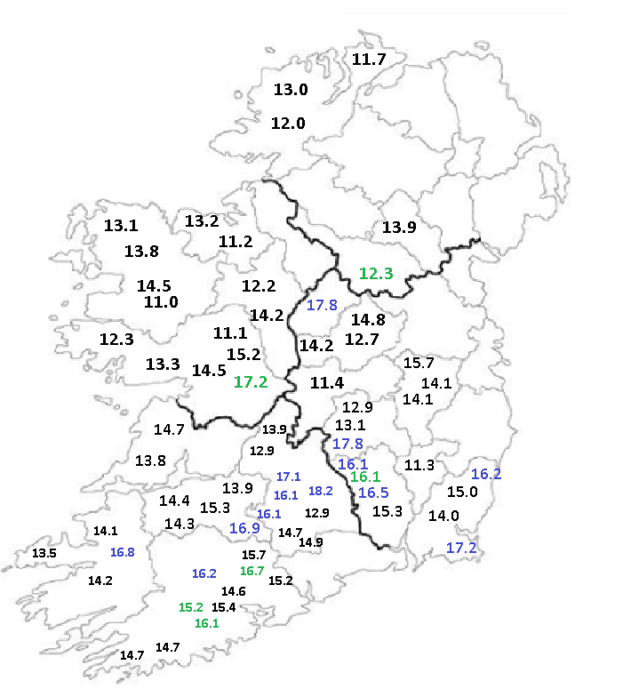

DM Production 2016 on Dairy Farms
Average DM Production 13.9 t DM/ha

Slide 58
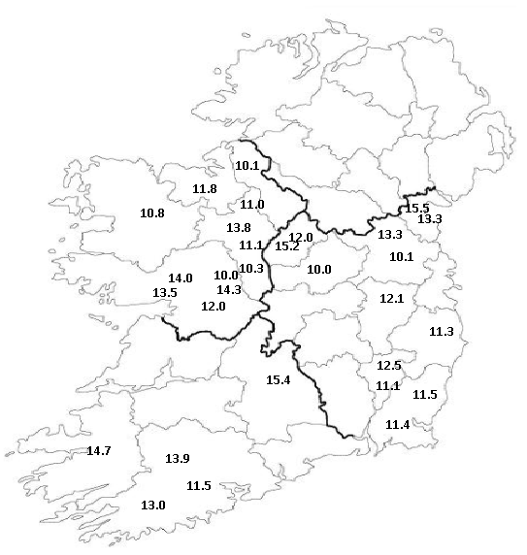
DM Production 2016 on Drystock farms
Average DM Production 12.2 t DM/ha

Slide 59


National Grass Growth Curve

Slide 60
Spring Milk Production
Milk 5,750 kg/cow
Fat 4.40%
Protein 3.60%
Milk solids 1,350kg/ha

Slide 61
The Grazing Year – Spring Calving Herd
Surplus
Feed Requirements
Deficit
Deficit
Calving & Turnout
Mid-season
The Feed Wedge
Housing
Dryoff
Spring
Spring Rotation Plan
Autumn
Feed budgeting (60:40 plan)

Slide 62
Integrated Grass-based Production Systems
kg DM / Hectare daily
100
Daily pasture growth rate
Integrated decisions
Alignment of
grass supply
&
animal requirements
Daily herd feed requirement
80
60
40
20
0
Jan
Feb
Mar
Apr
May
June
July
Aug
Sept
Oct
Nov
Dec
% of cows in the herd
100
Spring
Summer
Winter
Compact calving,
high fertility status
dairy herd
285+ DIM
80
CALVE
DRIED-OFF
60
CONCEIVE
40
20
0
Jan
Feb
Mar
Apr
May
June
July
Aug
Sept
Oct
Nov
Dec
“Simplicity is the ultimate sophistication” – Leonardo da Vinci.

Slide 63
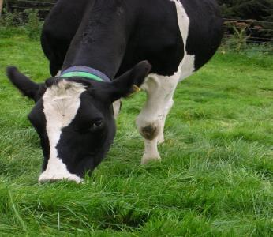
Grazing Management Objectives
High Animal performance
Kg MS/hectare
High pasture growth
Low feed costs
Maximise the proportion of grass in the diet
Supply adequate green leaf to the cow while conditioning the sward for future grazing
Feed budgeting –
  Achieve seasonal targets
  Identify and react to surplus/deficit quickly

Slide 64
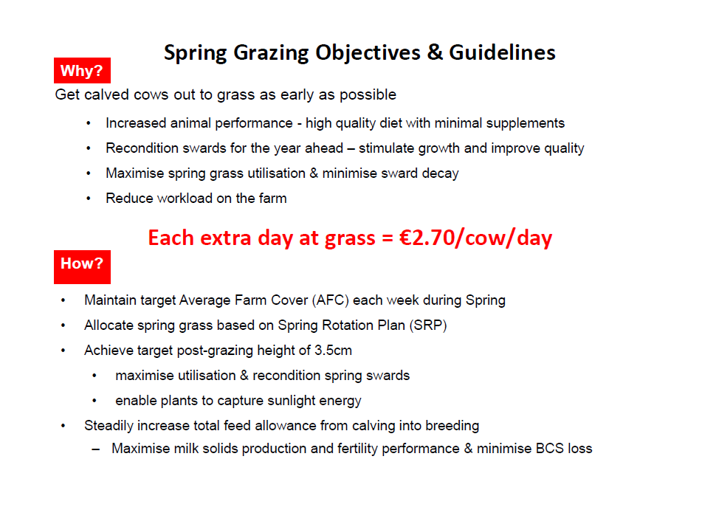
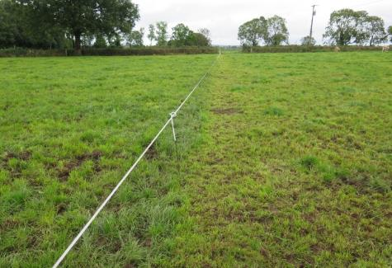

Slide 65
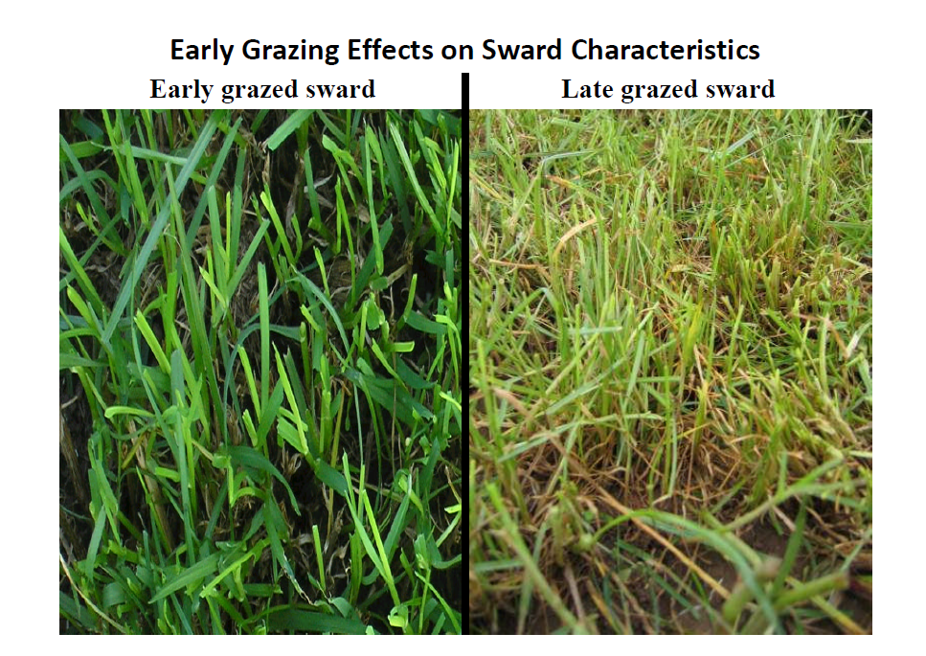

Slide 66
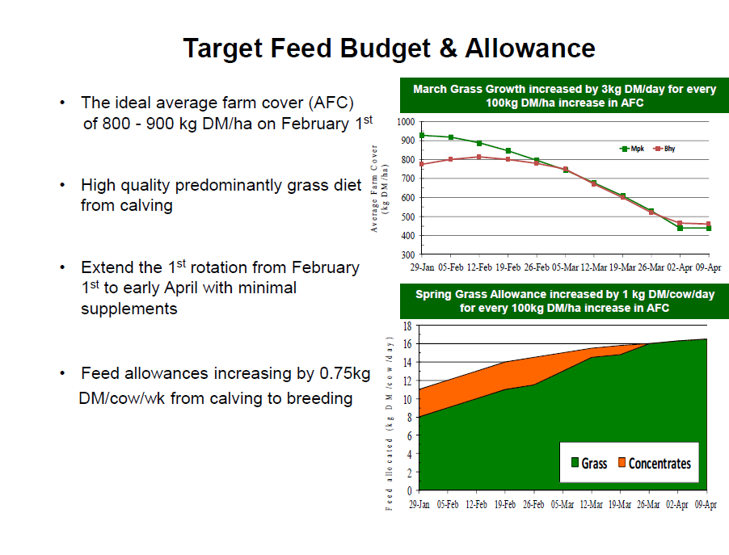

Slide 67
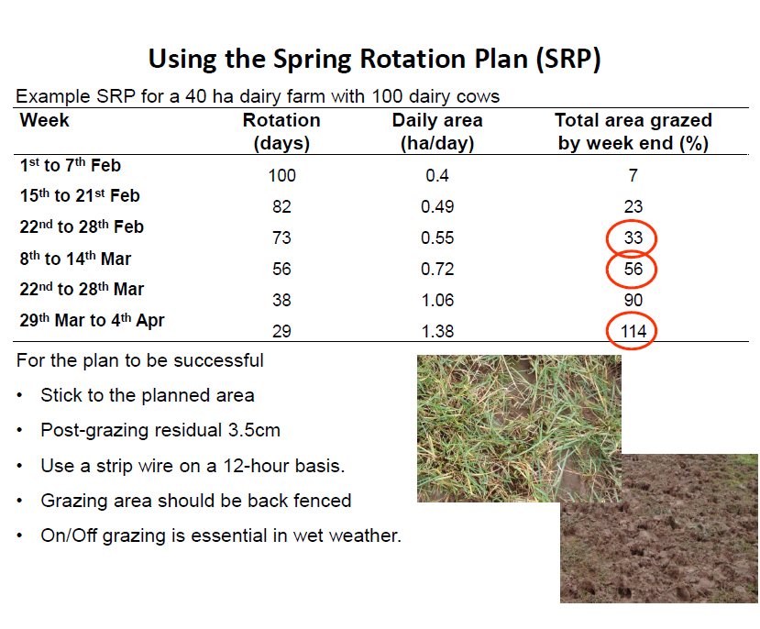

Slide 68
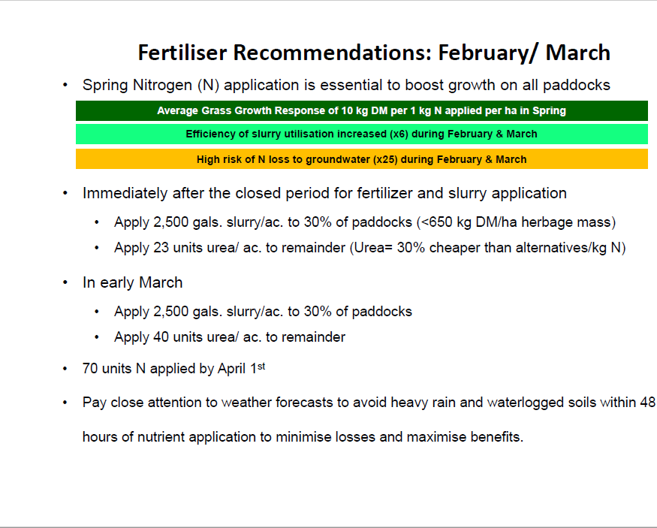

Slide 69
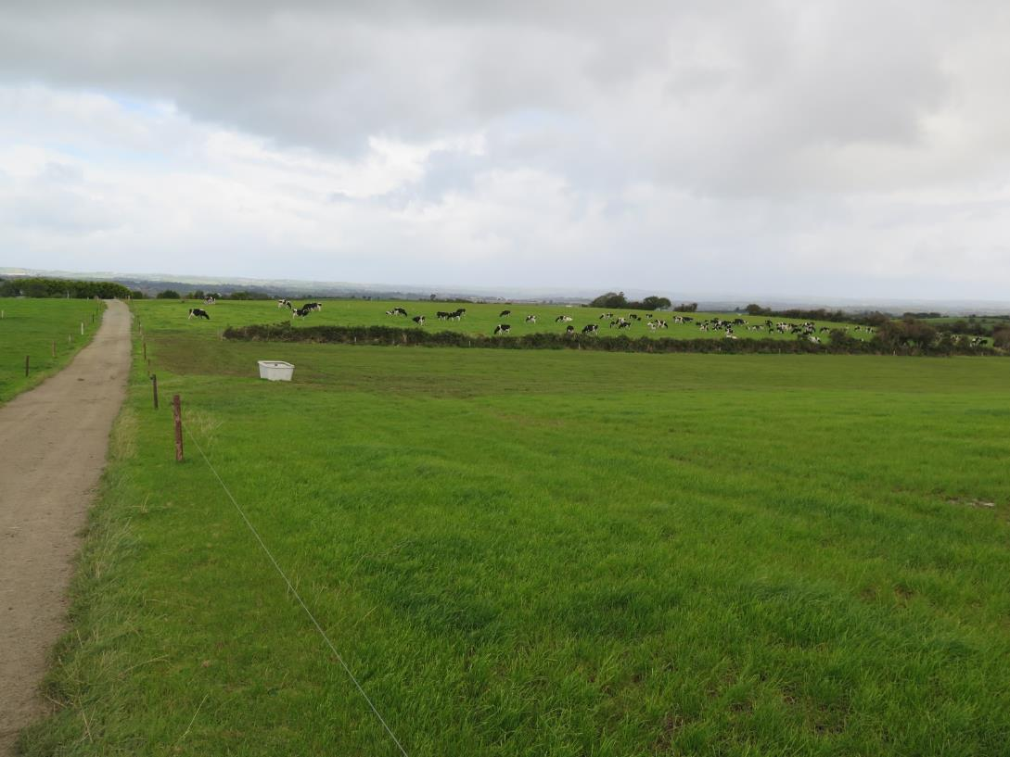
Mid Season Grazing Management

Slide 70




Slide 71


Slide 72




Slide 73


Autumn Grazing Management

Slide 74


Slide 75


Slide 76



Slide 77

Management system
PastureBase Ireland

Slide 78
What is PastureBase Ireland & who should use it?
Grassland Management Support Software
Helps farmers to quantify the amount of grass on their farm
Any farmer that wants to increase the profitability of their farm
Currently >5,000 farmers on the system

Slide 79




  Web based grassland management decision support tool
  National Grassland Database
  Farmer captures the data
  Core measurement is pre-grazing cover per paddock

Slide 80



What tools are included in the application?
Summer Wedge
Spring & Autumn Rotation Planners
Feed Budget
Fertiliser/Slurry application

Slide 81
Who is using PastureBase Ireland?
>3000 farms
>2500 Dairy farms
500+ Drystock farms
270 – Dairy and Drystock advisors and industry personnel
8 Teagasc Research farms
6 Agricultural Colleges
Aiming to increase usage to 4,000 farmers actively measuring in ‘18

Slide 82


Spring Rotation Planner: 40 ha Farm

Slide 83


Spring Rotation Planner

Slide 84


Grass Wedge- Identifying a grass Surplus/Deficit on the Farm

Slide 85

Grass Wedge- Data Generated to make Decisions

Slide 86


Autumn Rotation Planner

Slide 87
Requirements of the ideal grass
Grass DM Production (t DM/ha) 17-18
Energy level (UFL) >1
Organic matter digestibility (%) 82-86
CP (g/kg DM) 170-200
NDF (g kg/DM) 350-450
Dry matter (g kg DM) 150-210
Green leaf mass (%) >80
No reheading, high nutrient efficiency
Grass intake mid season (kg DM/cow) 18-20
Sward persistency (years) 7 - 10

Slide 88

What are high producing farms doing ?
High Soil fertility – Index 3, pH >6.0
Weekly measurement and proactive management
Low variation between highest and lowest paddocks
Spring grazing
More grazings per farm
Reseeding part of management

Slide 89
Number of grazings achieved and its association with total grazing DM production

Slide 90
15 Tonne Grass Map
Growth Period | Grass grown (kg/ha) | Rotn. Length (days) | No. of Rotations | Growth (kg/ha) required/day
1st Feb – 6th April | 1250 | 65 | 1 | 20
7th April – 5th Aug | 1,500 | 20 | 6 | 75
6th Aug – 1st Sept | 1,625 | 25 | 1 | 65
1st Sept - 1st Oct | 1,650 | 30 | 1 | 55
1st Oct – 15th Nov | 1,450 | 45 | 1 | 30
Total | 15,000 | 287 | 10

Slide 91
What has PastureBase Highlighted?
DM production can increase on all grassland farms
Variation across and within farms
Regional effect on DM production is minimal
Management is key to increase DM production
Huge variation in spring DM production on farms nationwide
Average farm cover at closing and at the start and end of the first rotation are critical targets for all grassland farms

Slide 92
The Netherlands

Slide 93

Inno4Grass – Education material on practical grassland management of The Netherlands
Agnes van den Pol – van Dasselaar
Leanne Aantjes

Slide 94

The Dutch dairy sector 2017
17.000 dairy farms
Average size 90 cows
50 ha, 8000-8500 kg milk per cow per year
11 billion kg milk before abolishment quota
80% FrieslandCampina
1.900.000 ha agricultural area
1.000.000 ha grassland
250.000 ha silage maize
Large area for dairy farming

Slide 95

Developments
Source: CBS

Slide 96
In 50 years
Average number of dairy cows per farm increased ten-fold, to about 85
Average milk production per cow doubled to somewhat more than 8,000 kg
The milk production per ha trebled to about 15,000 kg ha⁻¹
A ten-fold reduction in the number of dairy farms to about 18,000.
  Van Dijk, Schukking, Van der Berg, 2015. Grassland Science in Europe 20: 12-20.
Some characteristics of the Dutch dairy sector
Regional differences in soil quality
60% of NL below sea level (-1 to -7m)
Areas above sea level originally mostly poor sandy soils, fertilisation increased soil mineral content
Average net yield of grasslands 9 – 11 tonnes DM yr⁻¹
Rations characterised by relatively large amounts of supplementation, mainly maize silage, grass silage and concentrates

Slide 97

Trends about grazing in the Netherlands
Less grazing (90% of dairy cows in 2001, 70% in 2013, 65% in 2016, 68% in 2017)
Less hours per day grazing
Mainly rotational grazing, continuous stocking is increasing
Less grazing in south and east
Convenant Weidegang (Treaty Grazing)
Grazing premium
Grazing more prominent in education and science
Social issue
Political Parties proposed an obligation to graze
  Proposal got a majority
New government recently decided not to translate this into legislation (till 2020)

Slide 98

Grazing = Societal issue?
In the Netherlands: yes!
Cultural heritage, animal welfare
Started around 2000
2012: “Convenant Weidegang” (“Grazing Convenant”)
Aim: stable number of grazing cows
~ 75 parties signed the Treaty by now

Slide 99

18 June 2012 – Convenant Weidegang
“Grazing convenant”
Source: Duurzame Zuivelketen

Slide 100



Grazing Convenant
Dairy farmers: e.g. LTO Nederland
Dairy industry
Feed industry: e.g. Agrifirm, For Farmers
Banks: e.g. ABN AMRO, Rabobank
Accountants: e.g. Accon AVM, Alfa
Semen industry, veterinarians, cheese sellers
AMS industry: Lely, DeLaval
Retail: Albert Heijn, Jumbo Supermarkten
NGO’s: Dierenbescherming, Natuur & Milieu
Nature conservation: Staatsbosbeheer, Natuurmonumenten
Government
Education and science

Slide 101
Grazing premium
Grazing premium:
  CONO as first dairy company
  2012: FrieslandCampina (0.5 ct/kg), Rouveen
  2013: DOC Kaas, Vreugdenhil, Bel Leerdammer
  2015: FrieslandCampina (1 ct/kg)
  2016: CONO (2 ct/kg)
  2017 and 2018: FrieslandCampina (1.5 ct/kg)
Dairy farm of 1.000.000 kg milk: 15.000 Euro
Definition of grazing for the premium
  Minimum 120 days 6 hours per day
  Also a smaller premium available for 25% of the herd grazing

Slide 102


Reasons for less grazing
To control rations and optimise grassland utilisation
  When fed on grass only, DMI = enough to meet requirements of maintenance and 22-28 kg milk
Increased herd size
Increased use of automated milking systems
Reduced grass growth in summer time
Grazing “doesn’t sell”
Need to reduce mineral losses
Labour efficiency

Slide 103



Grazing in the Netherlands, % cows grazing
% cows grazing per region
Effect of herd size – large herds start grazing (% non-grazing)

Slide 104


Grazing in the Netherlands
Percentage of farms with grazing increases again
CBS, 2017
Source: Duurzame Zuivelketen

Slide 105

Grass growth 2014-2017

Slide 106

The effect of grazing on various aspects
Van den Pol-van Dasselaar, 2008

Slide 107

Economy – grass intake crucial factor
Source: Van den Pol-van Dasselaar et al., 2014

Slide 108




But what about economics under less favourable conditions?
Aim: to study the economics of grazing and zero-grazing for farms with less favourable conditions for grazing:
  Automatic milking
  Small grazing surface (25% instead of 75%)
  Larger herds (150 animals instead of 75)
  Higher milk yields per cow (9,500 instead of 8,000)

Slide 109




Economics of grazing
Van den Pol-van Dasselaar et al., 2010

Slide 110

Conclusions
In general grazing is economically more attractive than zero-grazing
The only exception is when the available grazing area is too small (grass intake less than 700 kg DM cow⁻¹ yr⁻¹)
The more grass the cows eat in the pasture, the larger the income profit
Economy is not the most important influencing factor for grazing in northwest Europe
If economy isn’t, what is?
The Netherlands: on-farm participatory research on 60 dairy farms (Koe&Wij)
In the end, personal preferences, experiences and habits of the farmer will be decisive in the choice between grazing and zero-grazing

Slide 111
How to increase profit?
Supplementation and grass intake are key factors
Advisors state: many farms can increase their profit with up to 10.000 Euro
  Increase grass intake
  Less supplementation
  No maize near the farm
  Optimise grassland management
  Start early and end late
Cost per kg DM for grazed grass on average 10 ct less than for conserved grass

Slide 112
Effect of grazing on farm income (Reijs et al., 2013)

Slide 113

Margin per cow for different grazing hours and different milk productions (Booij, 2015)

Slide 114

Results 2013
Accountancy data of commercial farms
2013 en 2014: ~ 1000 farms > 4 groups
  No grazing
  3 groups grazing, with different number of hours grazing per year
Results 2014
No effect on milk production per cow
With grazing: less concentrate costs, more roughage costs (due to lower annual grass production), no effect on total feeding costs
With grazing: less machinery costs
On average more € per 100 kg milk with grazing:
  < 1000: € 0.27 (not significant)
  1000-2000: € 0.82 (significant)
  >2000 € 0.74 (not significant)
  Note: grazing premium was € 0.50
Milk yield higher (0.5 ct grazing premium in 2014)
Less concentrate costs
Less total feeding costs
Higher profit
However: huge variation
Soure: commercial dairy farms Flynth;
Van den Pol-van Dasselaar, 2016

Slide 115

To graze or not to graze
Trend of decreasing % of dairy cattle with unrestricted stocking in Europe will continue
Behind this decline are economical, practical and personal motives
Number of grazing dairy cattle may be influenced by legislation, knowledge transfer and development of relatively simple grazing systems
Developments in dairy farming, especially increased herd size
Grazing scores well on the whole
Personal preference of the farmer determines the grazing system used
Knowledge on the effect of grazing is affected by personal preferences and experiences
Preferences may change:
  With time
  During major life events
  Communication with society
However, there’s another important influencing factor next to the elements already described: THE INDIVIDUAL FARMER

Slide 116


Dilemma: high herbage intake or high utilisation?
Productivity of dairy cattle is influenced by herbage intake and by nutritive value of the herbage
Very effective way to increase DMI is to increase herbage allowance
However, this results in lower herbage utilisation
Negative effect of higher residuals on subsequent grazings
Strategies
  Early grazing
  Restricted grazing forces the cow to graze more efficiently
  Leader follower system (high yielding – low yielding or dairy cattle – heifers or sheep)
  Topping?
There are opportunities to increase DMI by grazing dairy cows, but they are rather complex

Slide 117


Tools for measuring grass yield
Measure
  Rising plate metre
  Cutting and weighing
  Experience
  Satellites / drones
Measure weekly!
Several types of rising plate metres
  Manual
  Automatic
https://www.youtube.com/watch?v=9zp8PRConnM

Slide 118
Legislation: Nitrates directive and
Dutch Action Programme
Max 170 kg N from animal manure per ha related to leaching (Nitrates directive)
Netherlands: higher N uptake due to good climate conditions -> derogation up to 250 kg N (in situations of at least 80% grass)
Fertilization standards have been defined
Grassland based systems max. 250 kg N/ha
Max. active N/ha: from organic and synthetic fertilizer: 320 - 250 kg/ha, depending on soil type and grazing
Limitations on phosphate application, no distinction between organic and synthetic fertilizer
High output dairy farming systems in the Netherlands characterised by high fluxes of N and P
Research to avoid losses to the environment and to increase production efficiency
Insight into the flow of minerals at farm level
Practical tools for farmers, e.g. ANCA (Annual Nutrient Cycle Assessment)
From 2015 onwards, ANCA as licence-to-produce

Slide 119






Farm Specific Excretion (BEX)
Apply standards: easy to use, manure export is known
Using Farm Specific Excretion BEX:
  Ministry of Economic Affairs gave an opening
  Challenge: calculate farm specific excretion of N and P
  System is evidence based, transparent, maintainable
Stimulates farmers to improve their nutrient efficiency
Explanation:
https://www.youtube.com/watch?v=1cnERj9fooc

Slide 120




‘New’ fertilisers
Liquid fertilizer
Digestion of slurry
Dividing manure in a solid (mainly P) and a liquid component (mainly N)

Slide 121


FarmWalk®
Weekly tour through the fields
Individually and in groups
Look, measure, decide, do
Informed choices for the coming days, weeks, months
Result: in control

Slide 122





Grazing Coaches
Grazing Coaches train dairy farmers in FarmWalk®
  several meetings during the growing season, groups of 10 persons
They are trained themselves

Slide 123
Development FarmWalk®
2014
2015
2016
13 + 32 Coaches
45 + 30
1500 + 1500
400-500 Farm Walks
500 + 1000
75

Slide 124



Grip op Gras: tool for FeedWedge

Slide 125





Pasture grazing advices from farm task groups
1. There is a grazing system that suits you
      Where there’s a will, there’s a way of grazing
2. A good pasture manager is a flexible pasture manager
      After all, we are all facing the same weather,
      aren’t we?
3. Go with the flow; the cow is the boss
      A healthy cow has its own rhythm
4. Urea can definitely be influenced
      Less manure and more forage works miracles
5. Mowing as an instrument in grazing
      More taste due to mowing

Slide 126


Practical advise: grazing and large herds
Just do it!
  What is a large herd?
Everything larger...
  effects also..
Cow routing, water supply
Enough grass allowance
Divide the herd...
  High and low yielding, age, lactation stage
Short rotation in situations of trampling
No chasing, cows should set the pace

Slide 127



Innovations & Research topics in NL

Slide 128






Research on grazing
Technical
Economy / labour
Social

Slide 129


Mobile milking
Perspectives for
  Land on large distance from barn
  Partial grazing large herd
  Nature farming
Research themes “Natureluur” (NL)
(2008-2010)
  Technical development of this innovation
  Explore grazing systems with ‘Natureluur’
  How will cows behave?
  Optimize cattle management

Slide 130
Dynamic grazing; Choose the right grazing system
Choose the system that fits...
  your farm and
  your preferences
E.g. maximum grass growth and grass utilisation: strip grazing, rotational grazing
E.g. minimum labour: continuous grazing

Slide 131

Robot and grazing
See brochure (in Dutch): http://www.stichtingweidegang.nl/images/RobotenWeiden/Eindproducten/RobotWeiden_Concepten_102015.pdf

Slide 132




Tools; Fresh grass dashboard
Summer 2013
Kg DM intake per day from:
 | Concentrate
 | Others
 | Maize silage
 | Grass silage
 | Fresh grass grazing

Slide 133




Sensor data – grazing time
Practical tool for farmers
  Sustainability

Slide 134


Innovation: Virtual fence
0
1
2
3
4
5
6
7
8
9
Switch board
Energiser

Slide 135






Building blocks grazing
Supplemental feed
Grass intake
Cow behaviour
To find solutions for grazing
To translate into knowledge, management tools and grazing systems
Stimulates use and development of grazing in the Netherlands, as part of modern craftmanship, now and in the future
Grass supply
Grass growth
Soil

Slide 136
Belgium

Slide 137
Temperate legumes: key-species for sustainable temperate mixtures of Belgium
Peeters A.¹, Parente G.² and Le Gall A.³
¹Unit of Grassland Ecology, UCL, Belgium
²ERSA, Italy
³Institut de l’Elevage, France

Slide 138
Introduction
Renewed interested in forage legumes
Recent European research programmes:
  LEGSIL ‘Legume Silages for Animal Production’ 1997-2001
  LEGGRAZE ‘Low input animal production based on forage legumes for grazing systems’ 2001-2005
European research network:
  COST action 852 ‘Quality legume-based forage systems for contrasting environments’ 2001-2006

Slide 139

Species
White clover (Trifolium repens)
Red clover (Trifolium pratense)
Lucerne (Medicago sativa)

Slide 140




Secondary species
Sainfoin (Onobrychis viciifolia)
Birdsfoot trefoils (Lotus spp.)
Alsike clover (Trifolium hybridum)
Galega (Galega orientalis)

Slide 141

Novel species
Caucasian clover (Trifolium ambiguum)

Slide 142

Legume-grass mixtures
Compatibility between cultivars of two species
Ryegrass cultivars White clover cultivars
Late diploid
Large-leaved
Late tetraploid
Medium-size-leaved
Very late tetraploid
Small-leaved

Slide 143

Annual Production White Clover
White clover in pure stand:
about 6-9 t DM ha⁻¹
White clover/grass mixtures in good conditions in the west of Europe:
7-11 t DM ha⁻¹ and up to 20 t DM ha⁻¹
In the north of Europe, mixtures:
about 6-8 t DM ha⁻¹

Slide 144
Production White Clover
Earlier growth of grasses
Growth rate
Summer compensation
Pure grasses
White clover/grass
M
A
M
J
J
A
S
O
N
Optimal clover content
20-30%
40-50%

Slide 145
Production Red Clover
Red clover is higher yielding than white clover
Table 1. Typical annual yields (t DM ha⁻¹).
 | A1 | A2 | A3
Pure red clover swards
West of Europe | 10-14 | 7-10 | 3-4
South of Europe | 13-21 | 6-13 | -
North of Europe | 7-8 | 7-8 | -
Red clover/grass mixtures
West of Europe | 11-17 | 8-15 | -
North of Europe | 6-9 | 7-9 | 5
A1: first production year; A2: second production year; A3: third production year

Slide 146

Yield (t DM/ha)
Red clover/grass mixture yield
N-fertilized grass yield
N fertilizer (kg/ha)

Slide 147




 | Annual yield (t DM ha⁻¹)
Sainfoin | 7-15
Birdsfoot (monoculture) | 5-7
Alsike clover | red/white clovers
Galega (monoculture or mixture) | 8-10
Caucasian clover | ? in Europe

Slide 148

Nutritive value, voluntary food intake, animal performance
Legumes grasses:
higher digestibility, crude protein (CP), pectin, lignin, ash, Ca and Mg contents
poorer in total cell wall or neutral detergent fibre (NDF), hemi-cellulose and water-soluble carbohydrate (WSC)
nutritional superiority and higher intake characteristics

Slide 149

Nutritive value, voluntary food intake, animal performance
Legumes grasses:
High protein content in legumes can also be a problem
Inefficient use of protein in the rumen can lead to high levels of N-based pollution

Slide 150
Nutritive value, voluntary food intake, animal performance
High protein content: reduced proteolysis can be a way to solve the problem
Sainfoin and birdsfoot trefoils: Condensed tannins reduce the degradation of the main leaf protein (Rubisco) and to a lesser extent its solubilisation in the rumen
More non-ammonium nitrogen is thus supplied to the small intestine
Tannin contents at 20-40 g kg⁻¹: better efficiency in N utilization, prevent bloat and reduce the negative effects of internal parasites in sheep

Slide 151
Target: 40-50% white clover in summer
Dry matter yield (t/ha)
Production per animal
Nitrate leaching risk
Bloat risk
Optimum risk area
Source: Pfimlin, 1993
0
Clover proportion (%)
100

Slide 152

Meat production
DLWG on clover/grass (g/d)
1400
Average on clover/grass = 940
1200
1000
800
Average on grass = 908
600
400
400
600
800
1000
1200
1400
DLWG on ray-grass (g/d)
Source: Institut de l’Elevage, 1993

Slide 153
Dairy production
Milk per cow on clover/grass (kg/day)
30
Average on clover/grass = 20,2
25
20
Average on grass = 19,9
15
10
10
15
20
25
30
Milk per cow on grass (kg/day)
Source: Pflimlin et al., 1993

Slide 154


Nutritive value, voluntary food intake, animal performance
In silage
Red clover/grass :
    Similar energy contents and higher crude protein contents
    Better energy utilization and better energy gain
    Better intake for similar digestibility
    Better animal performance in beef production and in dairy cows
BUT
a part of the nutritional advantage of legumes can be reduced by leaf losses during the wilting and harvesting processes.

Slide 155


Bloat in cattle (and in sheep)
Occurrence low: < 0.8% per year
Oesophagus sphincter blocked
CO₂, CH₄, etc

Slide 156

Anti-quality factors and other secondary metabolites
Cyanogenic glucosides in some cultivars of
and
(asphyxiation in grazing animals). Levels generally low.
Significant infertility problems in sheep grazing because of phyto-oestrogens.
Cattle are less susceptible.
Cultivars with a low content are increasingly available.

Slide 157
Anti-quality factors and other secondary metabolites
Flavonoids as well as fatty acids can affect the chemical and sensorial properties of sheep (Cabiddu et al., 2001) and cow (Bertilsson et al., 2002) milk
Some forage legumes could increase the milk polyunsaturated fatty acid concentration and affect in a pleasant way the flavour of milk and cheese
BUT oxidation products of polyunsaturated acids, such as n-aldehydes and peroxides, can produce bad flavour in dairy products (Rochon et al., 2004)

Slide 158
Nitrogen fixation
Transfer of N from legume to grass can occur in three ways:
  exudation of low molecular weight organic-N compounds
  degradation of senescent legume organs (nodules, roots, leaves and stems)
  excrements of grazing livestock, especially urine
The second and the third route are the most important in grasslands
Underground transfer is 25-50% of the total (Ledgard, 1991)
Proportion of N fixed transferred to grasses highly variable:
13 to 34% (Heichel and Henjum, 1991)

Slide 159
Nitrogen fixation
Several types of assessment methods:
  Nitrogen yield difference (NYD)
  Nitrogen Fertilizer Replacement Value (NFRV)
  Acetylene reduction
  N¹⁵ isotope-based methods
All these methods have disadvantages and none is totally reliable
Some of the isotope-based techniques may be more precise

Slide 160



Nitrogen fixation
Typical values (kg N/ha.year)
White clover: 100-300
Red clover: 200-400
Birdsfoot trefoil, maximum: 140
Sainfoin: can be very low
The amount fixed is proportionate to the legume content of the sward:
 | N (kg) fixed per t of DM
White clover | 30-46
Red clover | 24-36

Slide 161
Nitrogen fixation
N transfer in grassland/crop rotation with red clover
Leys
About 6O kg N ha⁻¹ for the subsequent crop
Land set-asides
80-160 kg N ha⁻¹ for the following crop
after legume/grass mixtures
160-260 kg N ha⁻¹ after pure legume swards
Nitrogen
leys
crops

Slide 162




Utilization of white clover
Factors
N fertilizers | 0 N | High N
Period of N application | late summer and autumn | Spring and early summer
Type of N fertilizer | Organic | Inorganic
Type of animal | Cattle | Sheep low branching, thin short internodes of stolons, small leaf size, reduced WSC content of stolons
Period of sheep grazing | Autumn and early spring | Rest of the year
Defoliation interval | Frequent (grazing) | Infrequent (cutting)
Cutting system | Early (silage) | Late (hay) far red/red light ratio high: stolon branching and number of growing points reduced
Grazing/cutting combination | Interposed silage cut (restoration of stolons) | Trampling (harm stolons)
Grazing system | Rotational | Continuous

Slide 163
Clover proportion in summer (%)
45
40
35
30
25
20
0-25 26-75 76-150 151-250
Annual nitrogen fertilisation (kg N/ha)

Slide 164
Utilization of red clover
Adapted to infrequent defoliation and thus to conservation
Leaf losses increase with increased wilting: higher for hay than for silage
Dry matter losses at harvest: 14% to 45%
Leaf loss can be minimized by:
  reducing the number of times hay is handled
  handling hay at high humidity
  using hay conditioners
  using clover/grass mixtures

Slide 165
Utilization of red clover
Despite
  low WSC
  high CP contents
  high buffering capacity
Can be successfully ensiled if wilted
Use of an additive can help
Mixing red clover with grasses

Slide 166
Environmental issues in legume-based system
Legume-based systems have genuine advantages for the efficiency of N use compared with those based on inorganic N fertilizers:
  excess of N supply is avoided
  ammonium form is more abundant in the available soil N pool
In farm conditions, nitrate leaching losses smaller but stocking rates are usually lower too

Slide 167
Environmental issues in legume-based system
Release similar amounts of nitrate at comparable levels of animal production per hectare
BUT
Leaching in a clover/grass system relative to a 200N grass system varied from 50% to less than 30% (Ledgard et al., 1999)
Nitrate leaching after ploughing of clover leys: spring ploughing instead of autumn ploughing

Slide 168
Environmental issues in legume-based system
Reduction of fossil energy
(synthesis of inorganic N fertilizers)
Pimentel et al. (2005) compared a conventional cash-grain system with a typical livestock system (legume-based ley + crops)
Fossil energy inputs: about 30% lower in the second system

Slide 169

Environmental issues in legume-based system
Good source of pollen and nectar for some insect species
Flowers are attractive for the landscape
Many legume-based swards are too dense for birds that cannot use them as a breeding and a feeding cover
Lucerne is a notable exception: permeable to bird circulation and provides arthropods and nutritious leaves, a shelter against predators and a good nesting place if cut late

Slide 170
Conclusions and prospects
Two main attributes for future agriculture that reduces production costs and increase farmers’ income:
    capacity for N fixation
    high nutritive value and intake potential
In extensive systems: reduce N fertilization while maintaining sward yields at an acceptable level
One of the pillars of organic systems

Slide 171
Conclusions and prospects
Main shortcoming: lack of persistence
Grazing: occurrence of bloat should be minimized by the introduction of the genes of CT synthesis within the genome of clovers BUT consumer’s acceptance!
Conservation: development of techniques that can minimize leaf losses and control buffering capacity, ammonia content and development of undesirable micro-organisms

Slide 172
Conclusions and prospects
Main positive effect of legumes for the environment: reduction of fossil energy use and the emission of CO₂ to the atmosphere
Control of N emissions from legume-based systems
Future research: N fixation and utilization efficiency for legumes other than white clover and the impact of legume-based systems on the environment compared with other systems should be monitored by a set of reliable indicators

Slide 173
Conclusions and prospects
For livestock producers choosing legume/grass swards: trade-offs between performance per head and performance per hectare
Fundamental modification of forage-based systems (Rochon et al., 2004):
  greater extensification
  extension of the grazing season
  reduction in the conservation of fodder resources
  decrease of concentrate use per litre of milk
  introduction of new management practices
In dairy production, the quest for increasingly high production per cow would not be compatible with these new goals

Slide 174
Conclusions and prospects
Sufficient income by decreasing production costs through reducing:
  manpower, mainly by extending the grazing season
  inorganic N fertilizer use on grasslands and in grassland/crop rotations
  the housing period and the proportion of conserved feeding in the total diet
  concentrate per kg output thanks to a better intake of legumes compared with grasses
and through improving:
  conservation of legumes
  persistence (disease resistance, competitiveness)
  overall herbage quality for increased intake

Slide 175
Germany

Slide 176





Inno4Grass
Grassland syllabus Germany
culture
production
water
diversity
climate

Slide 177



Permanent grassland area in Europe
1.00
0.75
0.50
0.25
0
Grassland area
% of UAA
(Smit et al. 2008, AgricSyst 98, 208-219, Eurostat 2014)
annual rainfall (mm)

Slide 178


Grasslands and management systems are highly variable
(Source: Isselstein, 2018)

Slide 179




Grassland Ecosystem Services – ‘The big five’:
Production
Biodiversity
Climate
Water
Culture
production
diversity
climate
water
culture
(Source: Isselstein, 2018)

Slide 180
Grassland Ecosystem Services – ‘The big five’:
Production
Biodiversity
Climate
Culture
Water
production
diversity
climate
water
culture
(Source: Isselstein, 2018)

Slide 181

Estimated grassland productivity in decitons per hectare
(Smit et al. 2008, AgricSyst 98, 208-219, Eurostat 2014)

Slide 182

Dairy cow and beef cattle density in 2004 for EU-27 states (Lesschen et al., 2011)

Slide 183


Milk production in Europe by region, 2012
(eurostat 2014)

Slide 184

Development of permanent grassland area and cow number in EU-9 countries
(Eurostat 2010, Peyraud & Peeters, 2016)

Slide 185
Development of the forage production area in Germany
(DAFA 2015: The DAFA research strategy)

Slide 186
Feedbasis for dairy production (energy, NEL) in Germany in relation to estimation procedures
 | estimation
feedstuff | potentially | residual
grass | 43 % | 30 %
maize | 28 % | 34 %
concentrates | 29 % | 36 %
Ortgies 2017, unpubl.
estimation procedure
potentially: grassland performance calculated from official yield data
residual: grassland performance from residual calculation

Slide 187
Development of rent prices for arable and grassland in Germany (destatis 2016)
EUR/ha
Ackerland
Grünland

Slide 188
Price development of crude milk and wheat in Germany and relationship of milk revenue to wheat price
(eurostat 2016)
euro/100kg
milk/wheat (Euro/Euro)
crude milk
wheat

Slide 189
Milk production per ha agriculturally utilized area in Germany
(Lassen et al. 2008)

Slide 190


Permanent grassland area in Germany, data from 2016 (DMK, 2018)

Slide 191
Production trends in grassland in Germany
Dairy less dependent on grasslands (even though grasslands are often highly productive)
Marginal grasslands increasingly abandoned from agricultural use

Slide 192
Grassland Ecosystem Services – ‘The big five’:
Production
Biodiversity
Climate
Culture
Water
production
diversity
climate
water
culture
(Source: Isselstein, 2018)

Slide 193
High nature value farmland in Germany
Grassland is an important contributor to the biodiversity in the rural landscape
e.g. German wide study on ‚high nature value (HNV)-farmland*)‘ (Matzdorf et al. 2010, Fuchs 2011)
‚HNV-farmland‘: 13 % of the total farmed area
from this
‚HNV-grassland‘: 5,5 % (→ 14 % of total grassland)
‚HNV-arable land‘: 1,5 %
‚HNV-elements‘: 4,6 %
*) productive and non productive agriculturally utilized area

Slide 194

Grassland area (%) in designated nature conservation and environmentally sensitive areas in Germany
(Osterburg et al. 2009)

Slide 195

Status of FFH habitats in grasslands
trends: = stable, + getting better, - getting worse, ? unknown
(BFN, 2014)

Slide 196

Plant species number of patches of different sward height in a long-term grazing experiment
plant species number/m²
(Wrage et al. 2012, AEE 155, 111-116)
sward height class (cm)
0 – 6 6 – 12 > 12 sward height cm

Slide 197

Butterfly species richness in relation to the grazing intensity in a long-term grazing experiment
(Jerrentrup et al. 2014, JApplEcol 51, 968-977

Slide 198
Farm (left figure) and plot level (right figure) plant species diversity of grasslands of dairy farms in Lower Saxony, depending on grassland utilization
(Breitsameter & Isselstein 2015, GraslSciEur 20, 172-174)

Slide 199
Grassland Ecosystem Services – ‘The big five’:
Production
Biodiversity
Climate
Culture
Water
N20 and CH4 emissions
Carbon sequestration
climate
(Source: Isselstein, 2018)

Slide 200



Relative changes (%) in soil organic carbon after land-use change
(Poeplau et al. 2011, GCB 17, 2415-2427)
arable to grass grass to arable grass to forest
years after land use change

Slide 201


Carbon sequestration
t C ha⁻¹
Simulation study on the average annual net effect (t C ha⁻¹) on the carbon content of the soil organic matter due to conversion of arable land into grassland
(Vleeshouwers and Verhagen, 2002)

Slide 202

Grassland renovation/conversion and yield related emissions
(CO_{2äq} ha⁻¹/annual energy yield)
(Reinsch et al. 2018, SoilTillageRes 175, 119-129)
two experimental years
shown are results for the first year after renovation/conversion of grassland
PG: permanent grassland undisturbed
SR: spring renovated grassland
AR: autumn renovated grassland
CM: grassland conversion to silage maize

Slide 203
Grassland Ecosystem Services – ‘The big five’:
Production
Biodiversity
Climate
Culture
Water
Aesthetic value of grasslands
Recreation
Nature education
culture
(Source: Isselstein, 2018)

Slide 204






Aesthetic value of grasslands
Nature education
Recreation

Slide 205
Managing Trade-offs among functions …..
Knowing the (causal) relationship among different services
Identifying the effect of management measures on the delivery of multiple services

Slide 206

Relative amount of ecosystem services delivered by grasslands (schematic)
Service 1
100%
0%
Service 5
Service 2
Service 4
Service 3
Ecosystem services vary from 0 (no service/disservice) to 100% (maximum service possible under the particular conditions)
(Source: Isselstein, 2018)

Slide 207


Ecosystem services delivered by grasslands (schematic)
ecosystem services vary from 0 (no service/disservice) to 100% (maximum service possible under the particular conditions)
pre-industrial current intensive abandoned
production
100%
0%
culture
water
biodiversity
climate
(Isselstein & Kayser 2014: Grassl.Sci.Eur. 19, 199-214)

Slide 208


Grassland management intensity and ecosystem services outcomes (schematic)
Provision of ecosystem service
feeding value
max
min
water quality
ecosystem service
herbage yield
biodiversity
erosion risk
no low medium high no low medium high
defoliation frequency
(Source: Isselstein, 2018)

Slide 209


Grassland management intensity and ecosystem services outcomes (schematic)
Provision of ecosystem service
max
min
feeding value
water quality
ecosystem service
herbage yield
biodiversity
no mod. high excess no mod. high excess
nutrient input
(Source: Isselstein, 2018)

Slide 210




Schematic representation of the different types of functional relationships between two ecosystem services
mutually
exclusive
no
interaction
mutually
supportive
non linear
Service 2 (%)
Service 1 (%)
Solid line: current status, dashed line: changed relationship, e.g. through improved management, with increased total service
(Isselstein & Kayser 2014: Grassl.Sci.Eur. 19, 199-214)

Slide 211
Grassland Ecosystem Services – ‘The big five’:
Production
Biodiversity
Climate
Culture
Water
groundwater recharge
surface water runoff / flooding and erosion risks
quality of surface and groundwater
water
(Source: Isselstein, 2018)

Slide 212

Nitrate concentration in (leaching) soil water under different land use systems (UBA 2010)

Slide 213

Environmental issues – groundwater quality
Nitrate concentrations in groundwater bodies exceeding the threshold of the water framework directive
Regions with livestock production face problems!
Grassland typically no peak emmitant of nitrates to groundwater
Not necessarily grassland – but grassland is part of the farms
Consequently: on agricultural area higher untilization efficiency of excreted nutrients required, i.E. Nitrogen
(SRU, 2015)

Slide 214

Gross N balances in several european states
(Van Grinsven et al. 2012)
Annual soil N balance (soil N surplus) and N inputs from manure and fertiliser in 2008
→ 70% of n surplus affects environment primarily via nh₃, no₃, n₂o (uba, 2016)

Slide 215
German Fertilisation Law and Fertilisation Ordinance amended in 2017 to fulfill requirements regulated in the Nitrates Directive (1991)
Fertilization Law (2017) now formulates in §1 Purpose
„…Purpose of the present law is…..
to save the nutrition of crop plants…
….
to prevent and omit risk for the ecosystem due fertilisation…
to guarantee for sustainable utilisation of plant nutrients in the agricultural production, and in particular to prevent nutrient losses to the ecosystem as far as possible….“
→ new paradigm in the fertilisation: harmonises crop and ecosystem level

Slide 216
German Fertilisation Law and Fertilisation Ordinance amended in 2017 to fulfill requirements regulated in the Nitrates Directive (1991)
→ new paradigm in the fertilisation practice: harmonises crop and ecosystem level
Fertilization Ordinance (2017) now formulates in §1 Scope
„(1) The Ordinance regulates
the Good Agricultural Practice with respect to fertilisation….
the reduction of losses to the ecosystem….“
Good Agricultural Practice of fertilisation given:
maximum nutrient utilisation and low losses
fertilisation only permitted at high crop demand, otherwise losses
fertilisation at timepoints of high losses is prohibited

Slide 217
Fertilisation Ordinance (2017) – general points
Determination of nutrient demand required for N and P
Soil analysis not necessarily required (only advised) but at least official values for each year necessary
Nutrient content of own organic fertilisers not necessarily required (standard values ok)
Organic fertilisation: 170 kg N ha⁻¹ max. (Per total area of farm, single fields may receive more)
General fertilisation prohibition of liquid organic fertilisers during 01.Nov. – 31.Jan.
Farmyard manure: 15.Dec – 15. Jan.
Storage capacity for organic fertilisers of 6 months
In grassland application techniques with low emission (e.g. Trailing shoe, injection) required from year 2025
Adapted distances to surface water bodies, new regularies for frozen, wet and snow covered soils and fertilization after harvest of cereals in autumn
N balance until 2020: 60 kg N ha⁻¹, then 50 kg N ha⁻¹ (P: 20 and 10 kg P ha⁻¹, respectively)
Novelled N demand values for crops as function of yield (how measured in grassland?)
Grassland: N demand of e.g. 245 kg N ha⁻¹ for 4-cut system → subtraction due to
  Delivery from organic fertilization of preceding year (10% of totally applied organic N)
  N delivery from soil as function of humus content (e.g. <8% humus = 10 kg N ha⁻¹)
  N delivery by legumes (e.g. 10% legumes = 20 kg N ha⁻¹ year⁻¹)

Slide 218
Consequences for grassland fertilisation
  higher N utilisation required
  no slurry application after last cut in the year
  (only application techniques and adapted timepoints to increase nutrient utilisation)

Slide 219
Nitrogen yields of grassland with or without additional autumn slurry application in northern Germany on sandy soil (average 2004-2006)
0.7 or 0.6 kg N/kg N Input
0.8 kg N/kg N Input
Δ expected: 20 – 40 kg N/ha (50%)
10 m³ slurry 20 m³ slurry autumn 0 m³ 0 m³ autumn
autumn + spring only spring
(Lausen & Biernat, 2017)

Slide 220
Nitrogen yields of grassland with or without additional autumn slurry application in northern Germany on sandy soil (average 2004-2006)
Treatments compared were:
Autumn slurry treatments received additional slurry, i.e. 40 or 80 kg N ha⁻¹ additionally
Treatments + slurry autumn higher yield of ~10 or 20 kg N ha⁻¹
With efficient utilisation of at least 50% of the N in the slurry, the difference between autumn and spring treatments should range at 20 or 40 kg N ha⁻¹
Consequently only 25% utilisation, i.e. 1 kg N m⁻³
Utilisation marginal to low → expensive additional N yield
Slurry application after last cut in the year with negative consequences for environment and €

Slide 221

Slurry application prior to leaching period results in higher losses and lower plant available N
(Kolenbrander et al., 1981)

Slide 222

Slurry application prior to leaching period results in higher losses and lower plant available N
(Smith et al., 2002)
compensation by mineral fertilisation restricted due to N demand values

Slide 223

Slurry application prior to leaching period results in higher losses and lower plant available N
(ADAS, 2013)

Slide 224
Consequences of low N utilisation for nutrient balances on grassland
low efficiency due to autumn slurry on average 40% of the slurry N
high efficiency (modern technique, no autumn slurry) of 70%
N Input | 4 cuts, sandy soil
N demand | kg N/ha | 218
Organic N 170 kg/ha * 40% | kg N/ha | 68
mineral N | kg N/ha | 150
N Input | 4 cuts, sandy soil
N demand | kg N/ha | 218
Organic N 170 kg/ha * 70% | kg N/ha | 119
mineral N | kg N/ha | 99
N balance | kg N/ha
mineral N | 150
*N from slurry | 128
N yield grass | 198
N balance | 80
N balance | kg N/ha
mineral N | 99
*N from slurry | 128
N yield grass | 198
N balance | 29
refers to Fertilisation Ordinance, where 75% of slurry N are taken into account for N balance
target N balance 50 - 60 kg N ha⁻¹

Slide 225

Costs and benefits of N fertilisation
(Van Grinsven et al. 2013)
Negative externalities due to unadapted fertilisation management

Slide 226

Other rconsequences of slurry application under moist conditions in autumn
→ sward degradation due to propagation of Poa trivialis L. (rough meadow-grass = Gemeine Rispe)
yield share (%) of several species found in the first regrowth in a cut grassland in relation to soil compaction
not compacted
compacted

Slide 227




Poa trivialis L. – a problem in intensive grassland?
Primary growth of cut grassland regularly fertilized with slurry in autumn after last cut
First regrowth of cut grassland – differentiation by wheel tracs
L. perenne
P. trivialis
Komainda, 2017
Bavaria
P. Trivialis represents the second major grass found in permanent grassland of Bavaria during 2002-2008
(Kuhn et al., 2011)

Slide 228
Sward quality grassland – rough bluegrass (Poa trivialis)
(Hartmann et al., 2011)
DM yield [t ha⁻¹]
P. trivialis
L. Perenne min.
L. Perenne max.
Year 2010: 7 sites (BY: bavaria, TH: thuringia, SN: saxony-anhalt, BW: baden wuerttemberg; 40 varieties of L. Perenne

Slide 229


P. trivialis yields only ~50% compared to L. perenne
High share in sward consequently reduces nutrient utilisation (fertilisation law!)
Swards with a share of P. trivialis between 20 to 25 %, i.e. Yield losses of 10 – 12% should be resown with L. perenne under intensive management
Resowing requires between 150 – 210 € ha⁻¹ in a three-year cyclus
I.e. Annual additional gain of resowing of between 50 – 70 € required
If 1 t DM silage contain between 80 – 100 € of value
Resowing should yield between 0,4 and 0,9 t DM ha⁻¹ annually
Resown swards yield up to 60% higher compared to unsown (Hofmann & Isselstein, 2004)

Slide 230
Other consequences of slurry application under moist conditions in autumn → soil compaction and increased risk of N₂O emission
(Schmeer, 2012)
Δ4.6
unfertilised fertilised unfertilised fertilised
uncompacted uncompacted compacted compacted
N₂O emission
TM-Ertrag
DM yield
late fertilisation = high risk of soil compaction and consequently N₂O emission (N + reductive conditions in soil )
eco-efficiency: +N uncompacted vs. compacted +4.6 kg N₂O-N ha⁻¹ & -2.7 t DM ha⁻¹ =
0.5 vs. 0.9 kg N₂O-N t⁻¹ DM → late fertilisation with respect to climate critical

Slide 231

Further options for higher N utilisation in grass and forage production – home made proteins?
→ cultivation of legumes
→ problem: forage production frequently on light sandy soils with low pH
→ performance of alfalfa (Medicago sativa L.)?
Generally:
  soil samples
  0.4 – 0.5 kg S dt⁻¹ DM yield)
  1 kg ha⁻¹ B
  cold soils max. 40 kg N ha⁻¹ as starter
Options of sowing
Understorey in cereals
  15 – 25 kg ha⁻¹
  before shooting (BBCH 32)
  diagonal to drilling of cereals
Blank seeding
  End of april until august
  25 – 30 kg ha⁻¹
  12 cm row distances
pH soil = 7 → liming
rhizobia inoculation necessary

Slide 232

Blank seeding end of april with or without inoculation and liming with 15 dt ha⁻¹ coccolithic lime
Performance of alfalfa or alfalfa grass on a sandy soil
Site: Humic Podzol, sandy soil , pH ~ 5
no lime no rhizobia
+ lime + rhizobia

Slide 233

Influence on establishment
share of unsown species
no lime
+ lime top-dress
+ lime incorp.
no lime
+ lime top-dress
+ lime incorp.
no rhizobia
+rhizobia
(Pils, 2015, unpubl.)

Slide 234

Influence of lime application (head or incorporated) and rhizobia inoculation on yield during establishing year (3 cuts)
DM yield [dt ha⁻¹]
incorp.
incorp.
topdress
incorp.
incorp.
topdress
no lime
topdress
topdress
no lime
no lime
no lime
L. perenne
no rhizobia
rhizobia
no rhizobia
rhizobia
alfalfa
alfalfa + *grass
first
second
third cut
(Herrmann et al, 2015)
lime either incorporated prior to seeding or topdressed after seeding
*binary mixture of alfalfa and tall fescue (Festuca arundinacea) (15 and 20 kg ha⁻¹ alfalfa and tall fescue, respectively)

Slide 235

Energy content of alfalfa and alfalfa grass (Bavaria)
average energy concentration marginal
(LfL, 2014)

Slide 236

Forage quality – DM intake
+ 0.6 kg DMI/animal/d
Digestibility (%)
→ High digestibility and therefore high energy intake of legumes, i.e. Alfalfa
(Dewhurst et al., 2003)

Slide 237

Variety trials in Northern Germany – performance on sand?
Average 59 dt DM ha⁻¹ (sandy soil, pH 5.1, GD 5% = 7.7)
Average 135 dt DM ha⁻¹ (Haplic Luvisol, pH 6.9, GD 5% = 5.2)
DM yield [dt DM ha⁻¹]

Slide 238

Alternative legume? Trifolium pratense
2013
2014
2015
DM yield [dt DM ha⁻¹]
variety 1
variety 2
variety 3
mixture 1
mixture 2
mixture 3
red clover
red clover grass
mixture 1: 21, 21, 29, 29% italian, hybrid, perennial rygrass, red clover, respectively
mixture 2: 67 and 33% perennial ryegrass and red clover, respectively
mixture 3: 17, 33, 17, 20, 13% perennial ryegrass, meadow fescue, timothy, red clover, white clover, respectively

Slide 239
Adaptation for livestock production sites in the northern german plain (sandy soil + low pH)
  On grassland no slurry after last cut (low N efficiency, sward degradation + higher N₂O production)
  Principally alfalfa grown on light sandy soils possible (lime + inoculation with vital rhizobia strains necessary)
  Very good forage quality + high N contents (up to 350 kg N ha⁻¹ year⁻¹)
  Performance good to marginal – red clover more adapted (>100 dt DM ha⁻¹)
  No fertilization required
  Option for farms with problems to fulfill nutrient balances (‘homegrown protein’)

Slide 240
Poland

Slide 241


Effective use of permanent grassland in the feeding of dairy cows in Poland
Department of Grassland
and Natural Landscape Sciences
Piotr Goliński
Barbara Golińska
Artur Paszkowski

Slide 242
Utilized agricultural area in Poland (thous. ha)
 | 1990 | 2000 | 2005 | 2010 | 2017
Arable land | 14388 | 13940 | 12220 | 10428 | 10757
of which Temporary grassland | n/a | n/a | n/a | n/a | 414
Permanent meadows | 2475 | 2503 | 2528 | 2629 | 2796
Permanent pastures | 1585 | 1369 | 859 | 654 | 375
Own elaboration based on GUS, 2018

Slide 243

Location of permanent grassland (PG) in Poland
based on remote sensing
Area of PG
3.17 mln ha
GUS, 2018
Share of PG in AUA 21.7%
GUS, 2018
High habitat and physiographic diversity,
limiting the intensity of their use
Intensive PG producing good fodder - around 50% of the area
Extensive PG, natural and semi-natural meadows and pastures - about 50% of the area
  Dąbrowska-Zielińska et al., 2015

Slide 244
Share of permanent grassland in structure of UAA in selected voivodships (%)
Own elaboration based on GUS, 2018

Slide 245
Stock of cattle and dairy cows in Poland (thous. heads)
 | 1990 | 2000 | 2005 | 2010 | 2017
Cattle | 10049 | 6083 | 5483 | 5742 | 6143
of which Dairy cows | 4919 | 3098 | 2755 | 2529 | 2153
Own elaboration based on GUS, 2018

Slide 246
Cow’s milk production in Poland
 | 1991-95 | 2000 | 2005 | 2010 | 2017
Milk production (bn kg) | 15.40 | 11.49 | 11.58 | 11.92 | 13.31
Average annual quantity of milk per cow (kg) | 3083 | 3828 | 4147 | 4487 | 5687
under milk recording (kg) | 4209 | 5379 | 6508 | 6980 | 7771
Own elaboration based on GUS, 2018

Slide 247
Structure of fodder area in Poland (%)
Own elaboration based on GUS, 2018

Slide 248
Production and yield from permanent grassland (2017)
Meadows – 15.15 thous. t of hay
Pastures – 1.37 thous. t hay
Average yield – 5.21 t hay per ha
Production of hay from the first cut >60%
and from the second >50%
Own elaboration based on GUS, 2018

Slide 249
Potential yields from grassland in Poland
Own elaboration based on mutliyear PULS research

Slide 250



Models of milk production in terms of the fodder use from grasslands
intensive milk production using TMR/PMR system with important role of silage/haylage from permanent/temporary grasslands (milk yield 10000-12000 kg per cow), HF breed
low-cost technology of milk production with very important role of pasture and/or silage/haylage from permanent/temporary grasslands (milk yield 7000-8000 kg per cow), HF breed and/or dairy cattle breeds adapted to grazing
pro-ecological/ecological milk production with crucial role of pasture and/or hay from permanent/temporary grasslands – feeding without silage (milk yield 5000-7000 kg per cow), dairy cattle breeds adapted to grazing
Photographs Piotr Goliński

Slide 251
Fodder from grasslands in the intensive milk production
supplementation of the ration using in TMR/PMR feeding system
high quality silage/haylage from permanent/temporary grasslands
large expenditures on fodder production from permanent/temporary grasslands
regularly renovation of permanent grasslands
Goal → maximizing milk production

Slide 252
Fodder from grasslands in low-cost milk production
increasing the share of pasture and/or haylage from permanent/temporary grasslands in the feed ration
reduction of concentrates in the feed ration
optimization of inputs for the production of high-quality feeds from permanent/temporary grasslands
regularly renovation of permanent grasslands
Goal → reducing the unit costs of milk production

Slide 253
Fodder from grasslands in pro-ecological milk production
grasslands as an exclusive and only source of roughage in the ration
key role of pasture and/or hay from permanent/ temporary grasslands (feeding without silage)
regularly renovation of permanent grasslands
Goal → high-quality raw material (hay milk) for its processing into excellent quality dairy products (e.g. PDO products)

Slide 254
Pasture sward is the best feed in cattle feeding in terms of CLA
the content of raw fat in the sward is 3-5% of DM
the fat is composed of PUFA that are subject to isomerization in the rumen (linoleic, α-linolenic, oleic acids) with the participation of bacterias, e.g. Butyrivibrio fibrisolvens
the best composition of PUFA occurs in the summer
in pasture feeding, the Δ9-desaturate activity increases, which from vaccenic acid intensifies the synthesis of CLA in the mammary gland
an alternative to pasture is the inclusion of mown grass sward from permanent and temporary grasslands to compose TMR

Slide 255
High-quality milk from cows fed by grassland sward
Characteristics of milk from animals grazed on pasture or fed by meadow sward in barns:
increased content of essential fatty acids (MUFA and PUFA) omega-3 (α-linolenic), omega-6 (linoleic), CLA Iso
cis-9 trans-11
higher content of antioxidants - carotenoids, flavonoids, tocopherols (β-carotene, lutein, active form of vitamin E
α-tocopherol)
better flavour and taste values
From grass to glass
Scollan et al., 2005

Slide 256

CLA content in food products depending on the feeding system (in % of fat)
Khanal et al., 2003

Slide 257
Possibilities to increase the efficiency of fodder production from grasslands for cattle feeding
application of periodical renovations
use of valuable species and varieties of perennial forage plants
optimization of fertilization and sward management
application of proper irrigation
optimization of date and time of mowing/grazing the first regrowth
suitable organization of pasture management
optimization of sward harvest and forage conservation technology

Slide 258
Grassland renovation and establishment of new grass sward

Slide 259
Strategies and methods
for grassland renovation
Rejuvenation of existing sward without seeds
Partial sod renovation
using seeds
Total sod renovation
using seeds
Fertilization focusing on sward improvement
Selective herbicides application
Non-selective herbicides and direct drilling
Full tillage and drilling or broadcasting
Oversowing or overdrilling
Improved sward management
Goliński, 1998

Slide 260




Renovation using the method of overdrilling
Degraded grassland sward
Photographs Piotr Goliński
Effect of renovation – high quality sward
Increased profitability of milk production

Slide 261

Impact of improvement of sward by overdrilling on profitability
of milk production
Goliński and Kozłowski, 2000

Slide 262
Structure of the use of biological progress in grass and legumes breeding by type of farmers (%)
Goliński, 2017

Slide 263
Suitability of grasses and legumes for complementary seeding of permanent grasslands
Grasses: perennial ryegrass, meadow fescue (organic soils), hybrid ryegrass, Italian ryegrass, westerwold ryegrass, festulolium
Legumes: red clover, white clover, alsike clover (organic soils), bird's-foot trefoil, alfalfa
Varieties preferred for complementary seeding (the ability to quickly rooting - installation in old sward, high competitiveness)
Goliński, 2018

Slide 264
Suitability of grasses and legumes for mixtures using in total sod renovation of permanent grasslands
Ranking of the importance of grass species : perennial ryegrass, meadow fescue, tall fescue, timothy, smooth-stalked meadow grass, cocksfoot, red fescue, black bent, tall oat-grass, …
Ranking of the importance of the legume species : white clover (small-leaved varieties), alsike clover, red clover, bird's-foot trefoil, …
Goliński, 2018

Slide 265
Suitability of grasses and legumes for mixtures using in set up of temporary grasslands
Ranking of the importance of grass species: Italian ryegrass, westerwold ryegrass, perennial ryegrass (4n), festulolium, meadow fescue, timothy, tall fescue, cocksfoot, brome grass, …
Ranking the importance of the legume species: alfalfa, red clover, white (large-leaved varieties), alsike clover, crimson clover, persian clover, bird's-foot trefoil, Egyptian clover, common sainfoin, …
Goliński, 2018

Slide 266
Strategies of seed mixtures application in the establishment and renovation of grasslands
    1. The right selection of the seed mixture from the commercial offers of seed companies
    2. Mixtures prepared by an expert, designed depending on the habitat and the direction of grassland use in a specific farm

Slide 267
Characteristics of good quality seed mixture
    1. Species composition adapted to habitat and direction of use
    2. Use of varieties with high economic value (VCU assessment, post-registration variety testing and variety recommendation into practice)
    3. Seeds with high quality parameters (purity, germination)
good seed companies show in the commercial offer what varieties are used in the mixtures

Slide 268
Selection criteria of the species used for composing the mixtures
    1. Type of use (mowing, grazing, variable)
    2. Duration (permanent grassland - PG or temporary grassland - TG)
    3. Type of soil (organic, mineral)
    4. Humidity of the habitat (optimal, periodically or permanently flooded, periodically or permanently dry)
    5. The intensity of nitrogen use
    6. Competitiveness of species

Slide 269
Seed mixtures used in establishment and renovation of grassland
    1. Single species (variety) - TG
    2. Mixture of several varieties (of different earliness, ploidy) within one species - TG
    3. Simple mixture of 2-3 species of grasses or grasses with legumes - TG (PG)
    4. Multi-species mixture of grasses or grasses with legumes - PG

Slide 270




Multi-layered seed coating
protective polymer
layer
seed
calcium coating
bacterial strains of Rhizobium
NPKS,
microelements
protective
polymer layer
growth stimulants
Photographs companies materials
fungicides against Pythium

Slide 271







Sod seeders
Photographs Piotr Goliński and companies materials

Slide 272



Complementary seeders equipped in the Guttler roller system
Photographs Piotr Goliński

Slide 273




Low mowing
desiccant herbicide
Preparation of sod for overdrilling
Photographs Piotr Goliński
Active harrow
Rotavator

Slide 274
Impact of sod preparation methods before overdrilling on share of white clover in the sward
%
35
30
25
20
15
10
5
0
No treatment
Active
harrow
Low
mowing
Desiccant
herbicide
Rotavator
Goliński, 2001

Slide 275

Production in herbage from grassland more amounts of "native" protein
Grass-legume mixtures composed on the basis of functional features of the components
Photograph Piotr Goliński

Slide 276
Yield of meadow sward depending on the mixture composition and the level of fertilization
Mikołajczak, 1996

Slide 277


Multi-species mixtures for pastures with the addition
of meadow herbs
chicory and plantain improve the taste values of fodder and stabilize the distribution of yield during the growing season
Photographs Piotr Goliński

Slide 278



Influence of the species number in the mixture on feed intake and milk yield
A
B
C
Five
A
B
C
Five
Lp Fa Tr Tp
A 1 0 0 0
B 2/3 0 1/6 1/6
C 1/2 1/6 1/6 1/6
Five mixture of 5 species
Nitrogen fertilization=12 kg/t
of expected DM yield
Grass-legume mixtures yield better in comparison to single-species sward with the same level of fertilization
Collins et al., 2014

Slide 279





Direct drilling
Photographs Piotr Goliński

Slide 280

Renovation of grasslands using
a Horsch no-tillage seeder
Photograph Piotr Goliński

Slide 281
Grassland fertilization

Slide 282
Principles of nitrogen grassland fertilization
dose reduction on peat soils
maximum level of fertilization – marginal yield of 1 kg nitrogen not less than 10 kg DM
reduction in fertilization in the presence of legumes in the sward (1% of share means 3-5 kg/ha N less)
dividing the nitrogen annual dose (max. 60-70 kg/ha per regrowth), the fertilization criterion is the presence of N-NO₃ below treshold 0.2% in DM

Slide 283




Yield of grassland sward depending on type of nitrogen fertilizer (dt DM/ha)
Ernst, 1998
Photographs Piotr Goliński

Slide 284

The binding force and absorption of inorganic phosphorus against the background of soil pH
Grzebisz, Goliński and Potarzycki, 2014

Slide 285
Principles of potassium grassland fertilization
increasing the dose on peat soils
increasing fertilization in the presence of legumes in the sward
dividing the dose of potassium (max. 50 kg/ha per regrowth), the fertilization criterion is the presence of K at the optimal level of 1.7% in DM
include the luxury absorption of potassium of 90-100%
limitation of the rate on pastures by 20 kg/ha per year and per LU due to excrements

Slide 286
Water management on grassland

Slide 287






Anomalies of the total rainfall in spring and summer in 2013-2015 compared to the years 1971-2000
2013
2014
2015
spring
spring
spring
summer
summer
summer
Own elaboration based on IMGW, 2018

Slide 288






Anomalies of the total rainfall in spring and summer in 2016-2018 compared to the years 1971-2000
2016
2017
2018
spring
spring
spring
summer
summer
summer
Own elaboration based on IMGW, 2018

Slide 289




Changes in the precipitation and evapotranspiration in particular months in Wielkopolska in the years 1985-2014
parameter
evapo-transpiration
precipitation
change of precipitation/evapotranspiration [mm]
months
Goliński et al., 2015

Slide 290


Relationship of annual sward yield of grasslands and standardized precipitation evapotranspiration index (SPEI) for the 6-month period in 1965-2014 in Experimental Station Brody (Wielkopolska province)
Goliński et al., 2015

Slide 291



Irrigation of pastures in Poland - ensures continuity of feed supply during the growing season
Photographs Piotr Goliński

Slide 292

The increase of dry matter yield on irrigated and non-irrigated ryegrass pastures in the central part of Poland
Dry matter yield increase (kg/ha/day)
Growing season

Slide 293

Activities for the effective production of fodder from grassland in regard to climate changes
rational irrigation of grasslands on mineral soils
renovation of grasslands with the use of the best seed mixtures and new grass varieties resistant to thermal and moisture stress
limiting the effects of drought (application of manure fertilization, good potash nutrition, appropriate sward management treatments, weed control)
use of remote sensing through systematic monitoring of the status of grassland vegetation, which enables more accurate selection and dosing of fertilizers or more precise and efficient irrigation

Slide 294
Grazing management

Slide 295



Innovations in sward yield estimation and pasture grazing management
Photographs Piotr Goliński

Slide 296

The impact of cattle breed on production results in grazing feeding system
Significant improvement in calving and health indicators of cross-breeding cattle - better economic effect of milk production
Breed
HF Holstein-Fries.
Je Jersey
Je×HF crossbreed
Dillon et al., 2014

Slide 297

Grazing of dairy cows on the pasture in Poland
Photograph Piotr Goliński

Slide 298
Cutting and conservation of grassland sward

Slide 299

Optimal stage of meadow sward mowing
sward yield
dry matter digestibility
vegetative stage
heading
flowering
seed ripening
grass growth stage
Goliński, 2017

Slide 300

Optimal time for meadow sward mowing during the day
Mowing the sward
in the afternoon and evening
Lely, 2015
6 hours later = +20 g of sugars/kg DM
in 1000 kg DM
+20 kg of sugars more → +160 kg of concentrate feed

Slide 301





Effect of sward mowing term of first regrowth on quality of fodder and effectiveness of milk production
Specification
Sward mowing term of the first regrowth
heading
begin stage
of flowering
full stage
of flowering
NEL energy content (MJ/kg DM)
NEL energy yield (MJ/ha)
6.4
22400
6.0
24000
5.8
26560
Daily intake of a basic feed per cow
(kg DM)
13
12
11
Daily milk yield from the basic feed per cow (kg)
Milk production from the basic feed (kg/210 days)
Consumption of concentrates in the year (dt/cow)
14.3
3003
8
11.3
2373
11
8.5
1785
15
Rieder, 1996
Photographs Piotr Goliński

Slide 302








Technical innovations in the harvesting and conservation
of grassland sward
Photographs Piotr Goliński and companies materials

Slide 303



Photographs Piotr Goliński
Hay production based on drying in special barn

Slide 304
Factors determining the silage quality
A. Susceptibility of sward to ensiling
sugar content
buffer capacity
dry matter content
(degree of sward wilting)
soil contamination
occurrence in sward of lactic acid bacteria
B. Ensiling technique
fragmentation of the sward
compaction and density of sward
time of filling a prism or silo
silage additives
quality of foil used for covering or wrapping

Slide 305
France

Slide 306


Main livestock areas in France
Main herbivores system:
Dairy & beef cattle
Dairy & meat sheep
Dairy goat
Horses
 | Crop area with few livestock
 | Crop + livestock area
 | Grassland area from North West
 | Grassland area from Center and East
 | Fodder crop area
 | Pastoral area
 | Humid mountain
 | Highland
Source: SCEES

Slide 307
Key numbers on cows of France
Criterion | Before quota milk | 2017 | Main breeds | Secondary breeds
Dairy | 7.2 million cows | 3.8 million | Prim’Holstein | Montbeliard, Normand
Beef | 2.9 million cows | 4 million | Charolais, Limousin | Blond d’Aquitaine, Salers, Aubrac
Milk volume : 25 billion of litres
20 % variation between highest and lowest month delivery
In 2019, expect 1 billion organic milk
Suckler cows: 48% are hold (~2 million) by 21 % beef farmers who have more than 70 cows/herd)
Main production weanlings sold on store market (64%)
Source: GEB – Institut de l’Elevage, 2018

Slide 308

Classification of French dairy system from cows

Slide 309


Grazing in relation to the ration
Evolution of dairy cow ration throughout the year
Accessible area for grazing per cow
>= 0.8 ha
0.6 - 0.8 ha
Minerals
Grazed grass
Other fodder
Hay
Maize silage
Grass silage
Energy concentrate
Protein concentrate
0.4 - 0.6 ha
0.2 - 0.4 ha
0.1 - 0.2 ha
0 - 0.1 ha
No grazing
J F M A M J J A S O N D
Source: Observatoire des élevages laitiers

Slide 310

Cross between stocking rate and available grazing area will give proportion of grazed grass in ration

Slide 311




Composition & evolution of French forage area
% UAA
Fodder crop
Maize
Temporary grassland
Permanent grassland
Source: RGA 2010
% permanent grassland in FA
Source: RGA 2010
Annual forage
Temporary grassland
Source: Huyghe et al, 2015
Permanent Grassland
Rangeland

Slide 312

Dry matter intake per cow in fresh grass
Choose your objective (entrance at 12cm)
  More milk/cow:
    Ingestion 17 kgDM/day => residuals 6 cm
    Grass utilisation 1 600 kgDM/ha
  More milk/ha
    Ingestion 15 kgDM/day => residuals 5 cm
    Grass utilisation 2 400 kgDM/ha
Residuals (cm)
Kg DM/day
Grazing height at start (cm)

Slide 313
Grazing : set-stocking
Spring
Summer
Set-stocked
Set-stocked
Buffer area
Cut area
Set stocking |  | Cow |  | Goat |  | Sheep |  | Horse
Criterion | unit | min | max | min | max | min | max | min | max
Areas | are/LU | 30 | 80 | 30 | 60 | 70 | 90 | 50 | 90
Entrance | Compressed height (cm) | 7 | 8 | 6 | 8 | 6 | 8 | 5 | 7
Number of paddocks |  | 1 | 3 | 2 | 3 | 1 | 3 | 1 | 3
(Hoden et al., 1986 ; Doligez et al., 2014 ; Lefrileux et al., 2012 ; Leray et al, 2016 ; Pottier et al. 2009)

Slide 314
Grazing : rotational grazing
Rotational grazing |  | Cow |  | Goat |  | Sheep |  | Horse
Criterion | unit | min | max | min | max | min | max | min | max
Areas | are/LU | 25 | 60 | 25 | 40 | nc | nc | 30 | 80
Grazing | days / paddock | 3 | 5 | 2 | 4 | 3 | 7 | 3 | 7
Rest | days | 20 | 40 | 15 | 45 | nc | nc | 20 | 40
Entance | Compressed height (cm) | 8 | 15 | 12 | 14 | 10 | 15 | 5 | 10
Residuals | Compressed height (cm) | 3 | 6 | 6 | 8 | 4 | 6 | 3 | 7
Number of paddock |  | 5 | 15 | 4 | 8 | 6 | 10 | 3 | 7
Sources : Institut de l'Elevage et al., 2016 ; Doligez et al., 2014 ; Leray et al., 2016 ; Lefrileux et al., 2012 ; Pottier et al., 2009 ; Prairiales, 2005).

Slide 315

Cost of production before harvest, before and after distribution per ton DM
Cost of production before harvest, before and after distribution per ton DM
Into the trough
Harvest + Storage cost
Before harvest
Maize
Organic Maize
Italian RG
Sorghum BMR
Irrigated Maize
Alfalfa
Perm. Grass. Hay
Pear Millet
Red clover + HRG
Short rotation IRG
Fodder beet
Grazed Temp. Grass
Cereals + Leg Silage
Grazed fodder rape
Source: PEREL, 2013

Slide 316
Italy

Slide 317
Grasslands in Italy
Claudio Porqueddu¹, Rita Melis¹, Lorenzo Pascarella² e Giovanni Peratoner³
¹ CNR-ISPAAM, Sassari - ² AIA, Roma – ³ LAIMBURG, Bolzano

Slide 318


Climatic areas in Italy

Slide 319

Grassland types in Italy
Permanent Grasslands cover 3,3 million ha
Data: Eurostat. 2013

Slide 320

Livestock in Italy
Eurostat, 2017.

Slide 321

Trend of milk production 2012 - 2017

Slide 322
Grasslands in Mediterranean Italy

Slide 323


Issues concerning grasslands in Med regions
Map of potential forage production (Lee, 1983; Huyghe et al., 2014)
Med grasslands show a low production compared to the other European grasslands. Nonetheless, obtaining a higher DMY is not the main target
They have a pivotal role in the maintainance of HNV areas

Slide 324

Seasonality of forage production
The most important climate trait of Med areas is the concentration of rainfall during the relatively mild winter season and its total absence during hot summer, associated to a large intra- and interannual variability.
Problem: matching animal requirements with grassland forage availability
Daily growth rate of a Mediterranean semi-natural pasture
Grassland growth (kg ha⁻¹d⁻¹)
Perennial species
Integration with annual forage crops
Perennial species
Hay
Shrubs/trees
Stubbles
Transhumance

Slide 325
Grassland production
Pasture DMY (t ha⁻¹) in six sites (average of 5 years) measured with the method of Corrall and Fenlon (1978)
Site | Altitude | Type of soil | DMY (t ha⁻¹) |  | DM % | Extension of forage availability
 | (m a.s.l.) |  | Not fertilised | Fertilised
 |  |  |  |  |  | (in weeks)
BONASSAI | 80 | Limestone | 4.23 | 8.23 | 95 | +7
CHILIVANI | 350 | Alluvial | 2.77 | 5.05 | 82 | +7
BADDE ORCA | 600 | Trachitic | 3.13 | 5.52 | 76 | +3
PATTADA | 650 | Granite | 4.44 | 6.33 | 43 | +4
CAMPEDA | 650 | Basaltic | 3.92 | 6.41 | 63 | +3
S. ANTONIO | 650 | Basaltic | 2.39 | 5.38 | 122 | +8
From Bullitta and Caredda (1982)

Slide 326




Integration of grassland resources
Seasonal Use of Forage Resources (San Miguel et al., 1996)
Seasonal percentage of herbaceous, shrubs and trees in the diet of goats and sheep (Castro and Fernández Núñez, 2016)

Slide 327


Benchmarking of grasslands
TRADITIONAL METHOD
Point quadrat method (Daget Poissonet)
Focus on pastoral resource
management
Pastoral
Value
Method based on the concept of pasture type: semi-natural vegetation (mainly exploited by grazing animals), homogeneous in terms of botanic composition and influenced by environmental factors and agro-pastoral management.
Pastoral Value is a synthetic index that describes the agronomic value of a pasture
PV = 0.2 Σ SCP * Si (range: 0 – 100)
SCP = Specific Contribution of Presence for each species
Si = Specific index of a single species (score from 0 to 5)
correlation pasture production and stocking rate capacity
comparison of different pasture types within a region
useful also in pasture management for extra-productive purposes

Slide 328

Practices to improve grasslands
LEGUMES
Favourable environment to grow legumes (mild winters, long sunshine periods)
Animals grazing during all the year
The cheapest utilization; recycling of 70 to 80 % of the ingested nutrients
High N biological fixation: 70 to 200 kg N ha⁻¹ year⁻¹ under rainfed conditions
LEGUME-RICH PASTURES AND FODDER CROPS PRODUCED AND UTILIZED AT LOW COST !!!

Slide 329





Practices to improve grasslands
Pastoral annual legumes with hard seeds for permanent pastures
Trifolium subterraneum
Trifolium resupinatum
Medicago polymorpha
Ornithopus compressus
Biserrula pelecinus
Drought escape is the main adaptive strategy that exhibit for surviving during the dry period as seed
High tolerance to grazing

Slide 330
Variation in the pattern of hard seed breakdown of the same Medicago polymorpha accessions in relation to the year of seed production (Porqueddu et al., 1996)

Slide 331




Practices to improve grasslands
Perennial legumes for rainfed grasslands
- Drought tolerant species
Flexibile use (grazing/ hay)
Presence of beneficial secondary compounds
- Multi-use
Medicago sativa
Sulla coronaria
Onobrychis viciifolia

Slide 332


Practices to improve grasslands
Plants containing condensed tannins (<5%)
  Beneficial effects
Lower protein degradation rate in the rumen
higher amino acid absorption
lower burden of intestinal parasites and flies attacks
Higher animal production
Lower enteric CH₄ generation
Sheep grazing on sulla pasture in Sardinia
Sheep grazing on sulla pasture in Sardinia
From Waghorn and Hegarty, 2011

Slide 333



Practices to improve grasslands
Persistence in perennial grasses for permanent pasture
Average row cover (%) after 6 years. Mean values among six sites in Mediterranean environments
Lutetia
Medly
Survival after summer
Dactylis
Med origin
Dactylis
temperate origin

Slide 334
Practices to improve grasslands
DMYs and persistence of native grasses adapted to Med rainfed conditions
Dry matter yield of cultivars (t ha⁻¹) during a three-year field trial. From Porqueddu et al. (2008) and Annicchiarico et al. (2013)

Slide 335

Practices to improve grasslands
Seasonal production of native grasses adapted to Mediterranean environments
F. arundinacea
D. glomerata
Porqueddu et al. (2008)

Slide 336






Practices to improve grasslands
Use of mixtures of adapted native grasses and legumes
EU Action COST 852 “Quality Legume-Based Systems for Contrasting Environments”
Species belonging to 4 functional groups:
- Grass / Legumes
- Fast establishing / Slow establishing (= annuals/perennials)
NATIVE SPECIES (Dry Mediterranean mixture)
G₁= Lolium
rigidum Nurra
G₂= Dactylis
glomerata Currie
L₁= Medicago
polymorpha
Anglona
L₂= Medicago
sativa
Surigheddu

Slide 337




Extended seasonal forage distribution
Winter- Feb
Spring- May
> G1 and G2
> All species
Summer- July
Autumn- Nov
> L2
> G2

Slide 338

Practices to improve grasslands
Improving forage quality with the use of native species-based mixes
G1, G2 = grass
L1, L2 = legume
1= fast establishing species
2=slow establishing species
Average values of 5 harvests along the year
Maltoni et al. (2007)

Slide 339

Establishment and management
Seed innoculation: prior to sowing, the seeds of each legume species may need innoculation with specific and highly effective Rhizobium strains, in order to enhance symbiotic N fixation, making the system self sufficient in this important nutrient

Slide 340

Nutrient management
Legume-based pastures are self-sufficient in N but require adequate applications of other macronutrients, particularly P (at establihment and top dressed once a year) and if needed also other macro (K, Ca, S, Mg) or micro-nutrients (Mo, B, Zn, Cu, Fe, Co)

Slide 341




Sowing
Early in the Autumn (ideal soil temp. >16º C),
over a superficially prepared seed bed (minimum tillage)

Slide 342




Grazing management
Grazed during all the year with stocking rates adjusted to mean herbage yields
Building a seed bank in Spring
Natural regeneration after the Autumn rains
Deep grazing in Summer

Slide 343
Grasslands in Italian Alps

Slide 344
Fodder areas in South Tyrol
Temporary meadows
Silage maize
Home pastures
Meadows below 1,100 m
1-cut-meadows
High altitude meadows
(above 1,800 m)
Meadows 1,100 to 1,800 m
Summer pastures
below 1,300 m
Summer pastures
above 1,800 m
Summer pastures
between 1,300
and 1,800 m
Source: Peratoner et al. 2011 (mod.)

Slide 345
Contribution of grasslands to the overall forage production in South Tyrol
Silage maize
Summer pastures
(1,300 – 1,800 m)
Summer pastures
(> 1,800 m)
Temporary
meadows
Summer pastures
(< 1,300 m)
Meadows below 1,100 m
(≥ 3 cuts)
Home pastures
High altitude meadows
(> 1,800 m)
Permanent meadows (1 cut)
Meadows 1,100 to 1,800 m (2 cuts)
450,113 tons DM/year
Source: Peratoner et al. 2011 (mod.)

Slide 346
Difference between meadows and pastures
Meadows: the whole aboveground biomass is removed at once above a certain cutting height (more vulnerable to stress factors after the cut)
Pastures: by grazing, animals remove the aboveground biomass near to the ground, trample the plants and fertilise the vegetation with dung and urine

Slide 347
Elements of grazing - Selective grazing
Animals have definite preferences for some components in the sward (→ see the slide on palatability)
Accessibility (how easily the plants can be accessed by the animals) increases attractiveness for the animals, fungal diseases (i.e. rust infections) lower it
Species distributed in the upper layer of the sward’s canopy are more likely to comprise a higher proportion in the diet
Systematic selection of certain species by grazing can change the long-term composition of the sward → species intensively grazed than other are disadvantaged, the ungrazed ones have a selective advantage
Following selective grazing, patches of ungrazed vegetation should be cut/topped to prevent further spreading of ungrazed species and ensure uniform regrowth of the sward. If there is a large amount of biomass, it should removed from the field, otherwise it could rot and adversely affect sward growth and forage palatability
Animals learn (usually the young ones from the older ones) → known plant species are more easily accepted than unknown plants
Source: Frame & Laidlaw 2014

Slide 348

Animal species and selective grazing
Prehension: cattle tears off bunches of herbage, gathering them with their prehensile tongue, small animals with narrow muzzle select single plant parts and have prehensile lips.
* Cirsium sp., Carduus sp., Carlina sp.
** Horses have higher need for fibre-rich forage and can graze plant stands rich in grasses up to the emergence of inflorescence, but they become very selective beyond this phenological stage (Buchgraber & Gindl 2004); with both top and bottom incisors they can graze very close to the ground; according to Frame & Laidlaw they prefer short herbage
Source: Buchgraber & Gindl 2004, Ziliotto et al. 2004,
Frame & Laidlaw 2014

Slide 349

Grazing/browsing selectivity of different animal species
Source: Schneider et al. 2015 (mod.)

Slide 350






Selective grazing (some examples of avoided plants)
Rhododendron sp. Calluna vulgaris
Vaccinium sp.
Senecio alpinus
(=Senecio cordatus
=Jacobaea alpina).
Veratrum album
Grasses with coarse leaf texture
Shrubs
Poisonous plants

Slide 351
When should grazing start?
It depends on the adopted grazing method
In general: at latest when the upper stem node is 10 cm above soil ground (about 15 cm plant growing height, grasses are still before booting); not before the payback time has been concluded (3 leaves stage of pasture-suited grasses – reserves have been replenished)
Quick method to check grass availability for grazing using the average height of vegetation in extensively managed pastures (don’t take unpalatable species into consideration)
  Between half-calf and knee or higher (30 cm or more) → too much grass available
  Half calf (about 20 cm) → plenty of grass available
  Ankle (about 10 cm) → grass available
  Boot sole (3 cm or less) → no grass available for grazing
Source: Steinwidder and Starz, 2015; Pasut 2014, mod.

Slide 352
Elements of grazing - contamination by dung and urine
(50) 75 to 95% of the nutrients ingested by grazing animals may be returned to the soil (theoretically even more, if high amount of supplements are supplied to the livestock).
Dairy cow → about 0.6-0.7 m² covered daily with dung, 3-5 m² with urine; sheep → about 0.05 to 0.07 m² covered daily by dung.
With the exception of goats, dung is usually concentrated on night-lying areas, feeding troughs and tracks, water troughs, gateways and tracks.
Herbage contaminated by dung or growing in the vicinity of dung patches becomes unattractive to livestock. This effect is greater at low grazing pressure and if livestock is not accustomed to it.
Slurry applications depress acceptability until slurry is washed off by the herbage by rain.
Contamination by dung is increased at high growing by tall vegetation (more than 20 cm → late grazing start)
Source: Frame & Laidlaw 2014; Cavallero & Ciotti 1991

Slide 353
Effects of trampling (=treading)
Trampling by livestock hooves has mainly negative effects on the soil (soil compaction, mechanical damage to the plants).
Hoof stresses and the negative effects are enhanced
  livestock weight (1.2-3 kg/cm² pressure for cattle vs. 0.8-1 kg/cm² for sheep)
  by walking and running actions
  loafing and lying about
  wet weather
  slope
Species
  with profuse tillering (i.e. Lolium perenne)
  with folded leaf structure (i.e. Lolium multiflorum, Festuca pratensis and Phleum pratense are less suited)
  with creeping growth habit by stolons (Poa trivialis) or rhizomes (Poa pratensis) → better regeneration after damages
  prostrate rosette-plants
Trampling and the subsequent soil contamination reduce the attractiveness of herbage for grazing
Source: Frame & Laidlaw 2014; Cavallero & Ciotti 1991

Slide 354

Mixed grazing
Aim: to take advantage of the complementarity of the grazing behaviour of different animal species
Lead-follower-system: highly productive animals start grazing 1-2 days before less productive animals
Combination of grazing and browsing animals and of a selectively grazing species with a less selective one
Combination of a selectively grazing species with a less selective one. Reduced parasites pressure.
Good tolerance between species, but increase of parasite pressure (same gastrointestinal worms for both species).
Combination of different grazing behaviours. Reduced parasites pressure.
Source: Schneider et al. 2015

Slide 355



Methods to estimate forage production on pastures
Ingested herbage can be estimated by exclusion cages: animals are prevented from grazing certain areas (1 to 4 m²). Biomass production is measured within the exclusion cages at the end of the grazing period and residual herbage is subtracted by it.
The biomass available at a certain point in time is measured by means of a rising plate meter: the compressed sward height is measured using a device made out of a stick on which a plate is held at a certain height by the plant biomass. A correlation between compressed sward height and herbage biomass can be established. Other simpler methods are possible as well.
The production of a pasture during the growing season can be estimated by the Corral-Fenlon-method: a number of plots equal to the duration in weeks of the grazing cycle (usually 4 weeks) is established and each plot is harvested each week in sequence. For each plot, a mean growth rate for the period between one cut and the next is computed and the growth rates of all plots are averaged.
Source: a) P. D‘Ottavio

Slide 356
Methods of grazing: Continuous stocking
Free-range grazing of stock on an area
Maximum selectivity of grazing animals: avoidance of species of low palatability, high amount of necromass at the end of the grazing season (low proportion of grazed forage on offer → utilisation coefficient 0.3-0.6), deterioration of forage quality along the growing season (phenological advance, best spots are grazed first)
Less capital and labour needed for installation and operations
Good performance of single animals at the beginning of the grazing season, but lower productivity per ha. With the advance of the season the productivity drops because of overgrazing of the most favourable areas, the lack of young, leafy grass at the avoided areas as well as an increased need of looking for suited grazing areas over longer distances
Negative effects can be mitigated if a herder leads the animals towards targeted grazing areas (i.e. following an increasing altitude gradient)
Need for maintenance measures at the end of the season to prevent spread of weeds and shrubs
Not suited to farms with small scattered fields
Source: Frame & Laidlaw 2014; Buchgraber & Gindl 2001;
Ziliotto et al. 2004

Slide 357
Methods of grazing: Continuous variable stocking (including the so-called “Kurzrasenweide” =
“short sward grazing”)
A target average sward height is fixed and the stocking rate is adjusted changing the grazed area in response to the deviation from the target sward height.
A buffer grazing area is used to adjust the area to the livestock numbers.
Ungrazed areas can be cut for forage as the vegetation gets old.
Continuously
grazed
Cut once
before grazing
start
Cut twice
before
grazing
start
Source: Frame & Laidlaw 2014, Schmid and Kessler 2015

Slide 358



Methods for measuring sward height
1
x 0,79
x 0,56
Graduated stick
(uncompressed height)
Plastic lid method
(slightly
compressed height)
Rising plate meter
(compressed height)
Source: Steinwidder and Starz 2015

Slide 359

Methods of grazing: short sward grazing
Target growing height: 6-7 cm in spring and 7-8 cm during summer (uncompressed height)
Pre-requisites:
  Sites suitable for Lolium perenne and/or Poa pratensis (dense swards, tolerance against trampling and frequent defoliation)
  Flat to slightly sloped pastures
  Good water availability (soil water capacity, irrigation)
Source: Steinwidder and Starz, 2015; Schmid and Kessler, 2015

Slide 360
Methods of grazing: short sward grazing
Season
Growth rate (kg/ha/day)
2
LU/ha
Spring
2 weeks
before
harvest of
the first cut
4-7
LU/ha
Cut
3-5
LU/ha
Cut
Summer
2
LU/ha
Late summer/
autumn
Source: Steinwidder and Starz 2015, mod.

Slide 361
Methods of grazing: short sward grazing
Literature values of yield have been used assuming the harvest and feeding losses being 20% of the total yield and the first cut being 37% of the yearly harvest
Source: Steinwidder and Starz, 2015 (mod.)

Slide 362
Methods of grazing: Rotational stocking
Rotational stocking: the area is divided into a series of fields or paddocks that are grazed in sequence, each use being followed by a rest period. The total length of grazing plus the rest period is called the rotational cycle.
Paddocks are usually grazed for 2-6 days in case of dairy cattle and for 7-10 days in case of beef cattle, suckler cows, horses, sheep
A growing height of 4-5 cm at the time the animals leave the paddock should be targeted.
Individual animal performance is higher than in a continuous stocking system.
A certain flexibility in management is required to react to understocking in spring (see the effects of it as discussed for continuous stocking) and overstocking in the late season (→ poor animal performance). Actions include cut and conservation of forage produces in excess (speeding up of the rotation with paddocks left out for cut and conservation) or letting young cattle graze on the paddocks in the first part of the season and then sending it to the summer pastures; buffer feeding may be required if there is forage on offer is not enough (i.e. dry periods).
Management (→ grass budgeting, moving animals to new paddock, moving fences) and capital input high (→ fences, laneways, water pipes) can be high
Source: Frame & Laidlaw 2014; Buchgraber & Gindl 2001;
Ziliotto et al. 2004

Slide 363
Number of paddocks depending
on the grazing time (days/paddock)
Phase | Grazing time (days/paddock)
 | 3 | 6 | 10
Main growth | 6-9 | 3-5 | 2-3
Late summer | 12-16 | 5-6 | 3-5
Size of paddock (ha) depending
on the grazing time (days per paddock)
Grazing animals | Grazing time (days/paddock)
 | 3 | 6 | 10
10 dairy cows – whole day (WD) | 0.3 | 0.5 | -
10 dairy cows – 6 hours | 0.1-0.2 | 0.3 | -
10 suckler cows (dry) – WD | - | 0.4 | 0.7
10 beef cows (400-500 kg) - WD | - | 0.3 | 0.6
Source: Steinwidder and Starz 2015 (mod.)

Slide 364
Utilisation of paddocks during the season
Growth rate
(kg/ha/day)
Grazed
Mown
Source: Steinwidder and Starz 2015 (mod.)

Slide 365
Grazing time and rest periods in rotational stocking in summer pastures
30
40
40
34
45
36
42
Rest period
(days)
48
48
48
24
44
48
27
40
20
28
40
24
17
12
30
24
15
24
15
24
12
17
17
One LU requires about 70 to 120 m²/day on favourable sites (half of it in case of partial grazing), 100-400 m²/day in alpine summer pastures, depending on the yield potential of the site
The length of rest periods increases with the number of paddocks and decrease with the grazing cycle (→ phase of the growing season)
Source: graph → Aigner et al. 2003 (mod.), Koch 1996, Gusmeroli 2012

Slide 366


Occasional grazing
It is practised very often on meadows in autumn after the last cut (i.e. with young cattle coming back from the summer pastures)
A very early grazing in spring is recommended to control facultative weeds such as Umbelliferae (i.e. Anthriscus sylvestris, Heracleum sphondylium) and other dicots (Rumex acetosa, Taraxacum officinale, Geranium pratense)

Slide 367




Pasture maintenance
At least once at the end of the grazing season
Topping of avoided plant nests; weeds should be controlled as soon as they appear (some of them are indicators of overfertilisation → remove the causes of their occurrence)
Veratrum album
Senecio alpinus
(=Senecio cordatus
=Jacobaea alpina).
Rumex alpinus
Deschampsia caespitosa

Slide 368

Effect of pasture-based diet on the quality of milk products vs. diet based on conserved forage and concentrates
Source: Peratoner et al. 2015

Slide 369

Effect of pasture-based diet on the quality of meat products vs. diet based on conserved forage and concentrates
Source: Peratoner et al. 2015

Slide 370
Pros and cons of pasture-based grassland production
Pros
  reduced production costs
  reduced labour demand
  improved animal welfare
  pastoral landscape (relevant to tourism)
  high conversion efficiency from forage to food (if plants are grazed at an early phenological stage)
  Improved nutritional value of products (milk, meat)
Cons
  lower per-cow yield and thus reduced revenue (not necessarily reduced income) + increased demand for land availability
  high demand on management competence
Source: Thomet et al. 2011

Slide 371
Prerequisites for a successful pasture-based production
Sufficient land availability
Sufficient proximity of areas to be grazed to the farm buildings
Topography suitable for the grazing livestock (species and breed requirements should match the given topography)
Acceptance for reduced cow performance
Use of suitable breeds (especially concerning cows)
Reduced body weight (important on steep slopes)
Ability for high intake of herbage relative to energy demand
Ability to maintain body condition on grass diet
Reduced requirements for concentrate supplementation
High reproductive performance

Slide 372
Temperate grasslands in Italy

Slide 373
Source: ISTAT,2017

Slide 374



The Po Valley is the most extended area with continental temperate climate in which permanent grassland are traditionally large diffuse
Grassland is “permanent" if is not plowed for at least 10 years. Thus, Permanent grassland are never alternated with other crops and are managed through cutting, irrigation (in the flat land) and fertilization (Bocci M. et al, 2011 ).
Pieve di Bibbiano, grassland whose existence dates back to about 1300
In the Po Valley 60% of permanent grassland exceed 75 years and only 15% has been sown or renewed over the last 25 years (CRPA, 2007)

Slide 375






Biodiversity: more than 60 botanical species have been surveyed on these fields, present significantly and continuously.
IRRIGATION of grassland: traditionally the grassland in the valley are irrigated the first part of summer.

Slide 376

Temporary grassland enters in a crop rotation: soil’s characteristics determine the
choice of legumes (pH, lack of limestone and waterlogging), grasses are more
conditioned by the climate. Usually < 10 years
Among the criteria for choosing the varieties to be combined there is the necessity to have flowering
of legumes and grasses in the same time (better feed value and production):
• in mixtures with alfaalfa it is good to use late varieties of Dactylis glomerata and Festuca arundinacea;
• in mixtures in which the legumes are made of white clover, choose variety of grasses with intermediate precocity;
• when is present Phleum pratense, it is necessary to use the most precocious varieties.
Dactylis glomerata
Festuca arundinacea
Red clover
White clover
Source: CRPA, 2014

Slide 377


Fertilization: both permanent and temporary grassland are fertilized in many cases
The adoption of fertilization management that recovers the uptake of the crop is
sufficient to mantain the soil fertility avoiding leaching. An increase fertilization
doesn’t increase quality by more than 10 % (Bonifazzi B,,2009).
In the permanent grassland, fertilization is an instrument of floristic and productive rebalancing
Grassland can effectively use the manure to maintain fertility, in the temporary grassland are distributed (during plowing and every autumn) even doses of phosphorus and potassium (about 50 kg/ha)

Slide 378
Renewal of degraded grassland
Important instrument where the fodder crop are of low quality
or weeds have increased dramatically
Rationalizing fertilization. It is a powerful factor for modification of the grassland composition (grass/legume)
Overseeding. Useful to thicken the field with the direct sowing of good forage crop; it is applied with the availability of water to ensure germination
Reseeding. When the degradation is total, the field is completely renewed. After a superficial soil working , a mixture of grass/legume is sown

Slide 379

Management-Biodiversity
An intensive management of the grassland, especially characterized by frequent cutting, loads to reduce the species and, in limited cases, leads to "permanent monoculture" of Italian ryegrass.
A better management (< cuts and/or rotational stocking) increases the biodiversity
In fields with good biodiversity, more grasses are present in addition to ryegrass and Poa, e.g.Dactylis glomerata, bromus , festuca, oats and Holcus lanatus.
Non-cutted grassland strips are left to increase both vegetal and entomological biodiversity

Slide 380
Permanent grassland fixes about 180 tons of carbon per hectare in the first 50 cm of soil, more then 25% respect to one ha of arable land
Carbon sink
Arable land
0,00 50,00 100,00 150,00 200,00 250,00
conte nt (t*ha- 1 )
coltura
P. grassland
Permanent grassland soils have a significantly higher stability index than arable land. This can be due to higher presence of organic matter
Comparison between soil aggregates
80
70
60
50
40
30
20
10
0
p. grassland
cont rol
31
1
15 6
Sampling unit
23
25
Source: Parma province, 2005

Slide 381


Permanent grassland in Italian temperate region are strictly linked with dairy cow breeding of Grana Padano and Parmigiano Reggiano chains.
Permanent grassland provide excellent quality forage which responds in a balanced way to the nutritional needs of the livestock, playing an important role in defining the sensorial attributes of Parmigiano-Reggiano (CRPA, 2007).

Slide 382


Production of grassland in temperate areas
Hay production depends on the seasonal trend and management averaging 10-11.5 tons per hectare from 3-4 cuts (5 cuts in particularly favorable seasons) of which the first, most abundant, is carried out in the first half of May while the others are carried out at a variable distance of 35/40 days.
The FU contents calculated for the production of grassland are in a range from 0.65 to 0.69 - 0.74 FU/kg of DM (Superchi et al., 2007), up to 0.8 UFL/kg of DM contained in hay (INRA, 2002).

Slide 383
Thanks to all contributing partners of Inno4Grass

